Slide 1
Organizing Data for Effective Analysis
Chapter 7
Notes:
Use the quote as a jumping off point for discussion, if desired.

Slide 2
Chapter Introduction
Managing and analyzing large amounts of nonnumeric data using lists, a PivotTable report, and XML
To go to Level 1, click here
To go to Level 2, click here
To go to Level 3, click here

Slide 3
Functions Covered in This Chapter
CONCATENATE
FIND
LEFT
RIGHT
SEARCH
TODAY
TRIM
YEARFRAC

Slide 4
Level 1 Objectives: Importing and Structuring Text Data in Excel Worksheets
Import text data into a worksheet
Concatenate values and extract characters from a text string
Convert text into columns of data
Analyze data by creating subtotals
Create, sort, and filter an Excel table

Slide 5
Working with Text Data
Comma-delimited files
Separate values in each record with commas
Also called comma-separated values (CSV)
Once imported into a worksheet, each value in a record appears in a separate cell
Level 1 home

Slide 6
Working with Text Data (continued)
Goals:
Determine the format you need so you can find the best way to change unstructured data into structured data
Change the format of unstructured data
Level 1 home

Slide 7
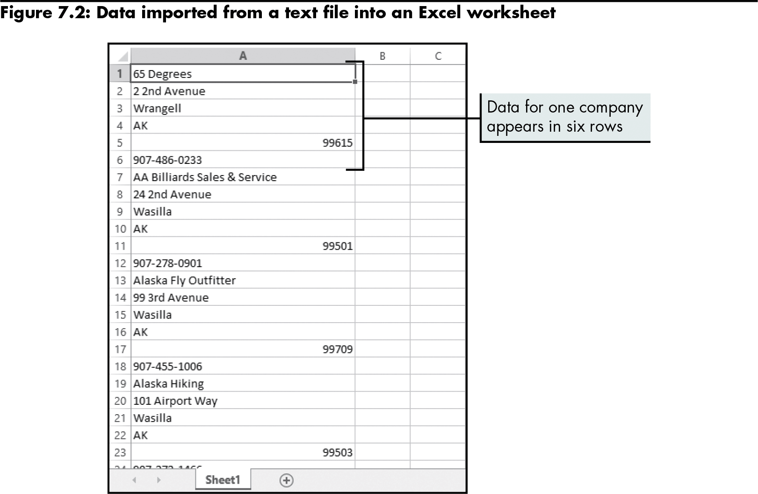
Working with Text Data (continued)
Level 1 home

Slide 8
Combining Text Using the CONCATENATE Function
CONCATENATE function
Combines values in a range of cells into one text item in a new cell
=CONCATENATE(text1,text2,…)
Level 1 home

Slide 9
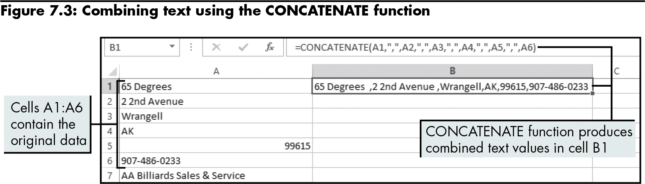
Combining Text Using the CONCATENATE Function (continued)
Level 1 home

Slide 10
Extracting Characters from a Text String
May be used to remove incorrect entries
RIGHT function
Returns the last character(s) in a text string based on the number of characters specified
=RIGHT(text,[num_chars])
LEFT function
Extracts the characters from the beginning or left side of a text string
=LEFT(text,[num_chars])
Level 1 home

Slide 11
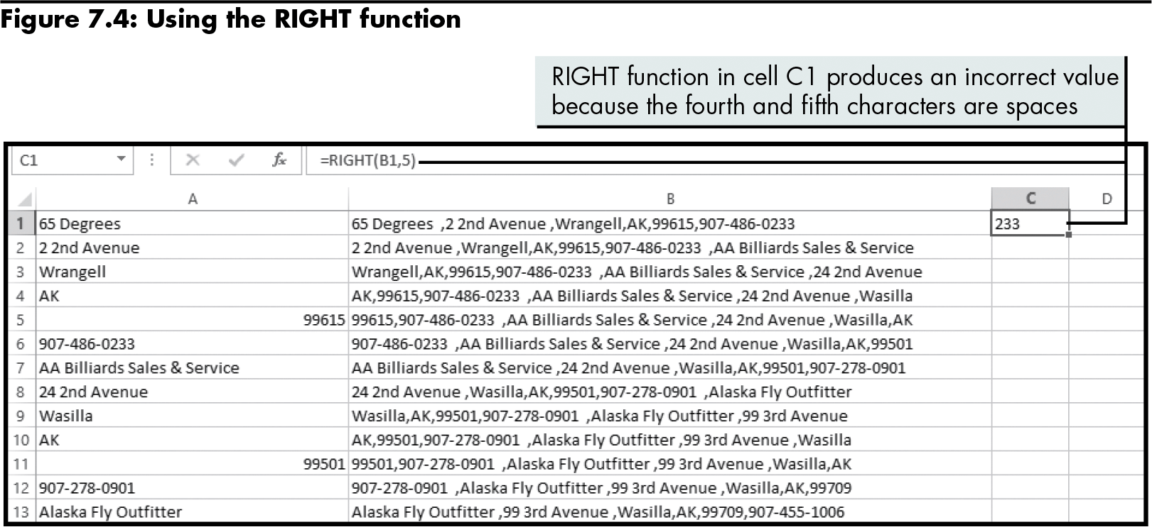
Extracting Characters from a Text String (continued)
Level 1 home

Slide 12
Extracting Characters from a Text String (continued)
TRIM function
Removes all spaces in a text string except for the single spaces between words
=TRIM(text)
Level 1 home

Slide 13
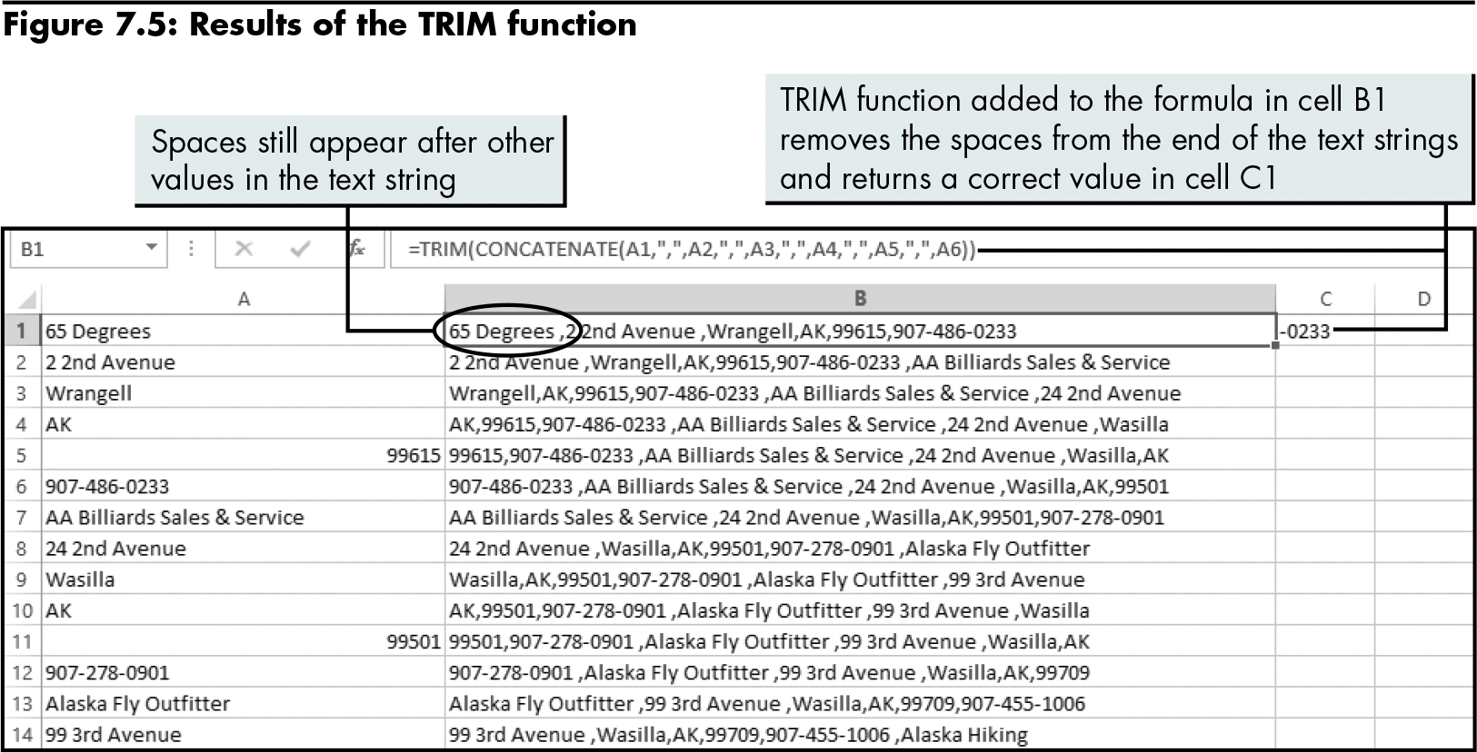
Extracting Characters from a Text String (continued)
Level 1 home

Slide 14
Extracting Characters from a Text String (continued)
FIND function
Returns the starting position of one text value within another text value
Case sensitive
=FIND(find_text,within_text,[start_num])
SEARCH function
Does the same thing as the FIND function, but is not case sensitive
Level 1 home

Slide 15
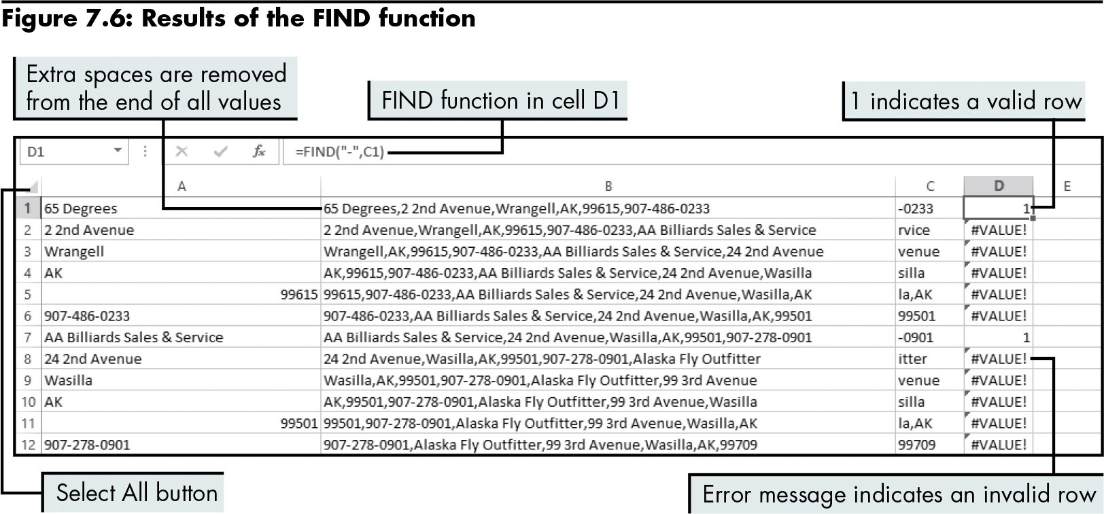
Extracting Characters from a Text String (continued)
Level 1 home

Slide 16
Extracting Characters from a Text String (continued)
Sorting and removing invalid data:
Copy the contents of a worksheet into a new worksheet to preserve the original data and eliminate the potential problem of automatically updating formulas as data is modified
Sort the data in the new worksheet to separate valid rows from invalid rows
Valid rows contain a “1” and appear first in the sort
Delete invalid rows
Level 1 home

Slide 17
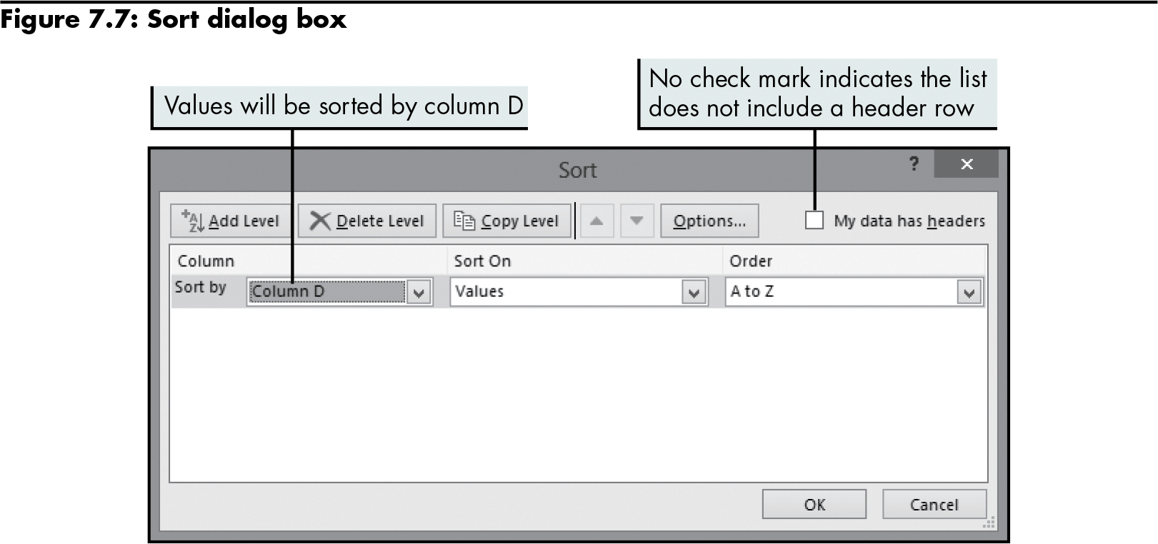
Extracting Characters from a Text String (continued)
Level 1 home

Slide 18
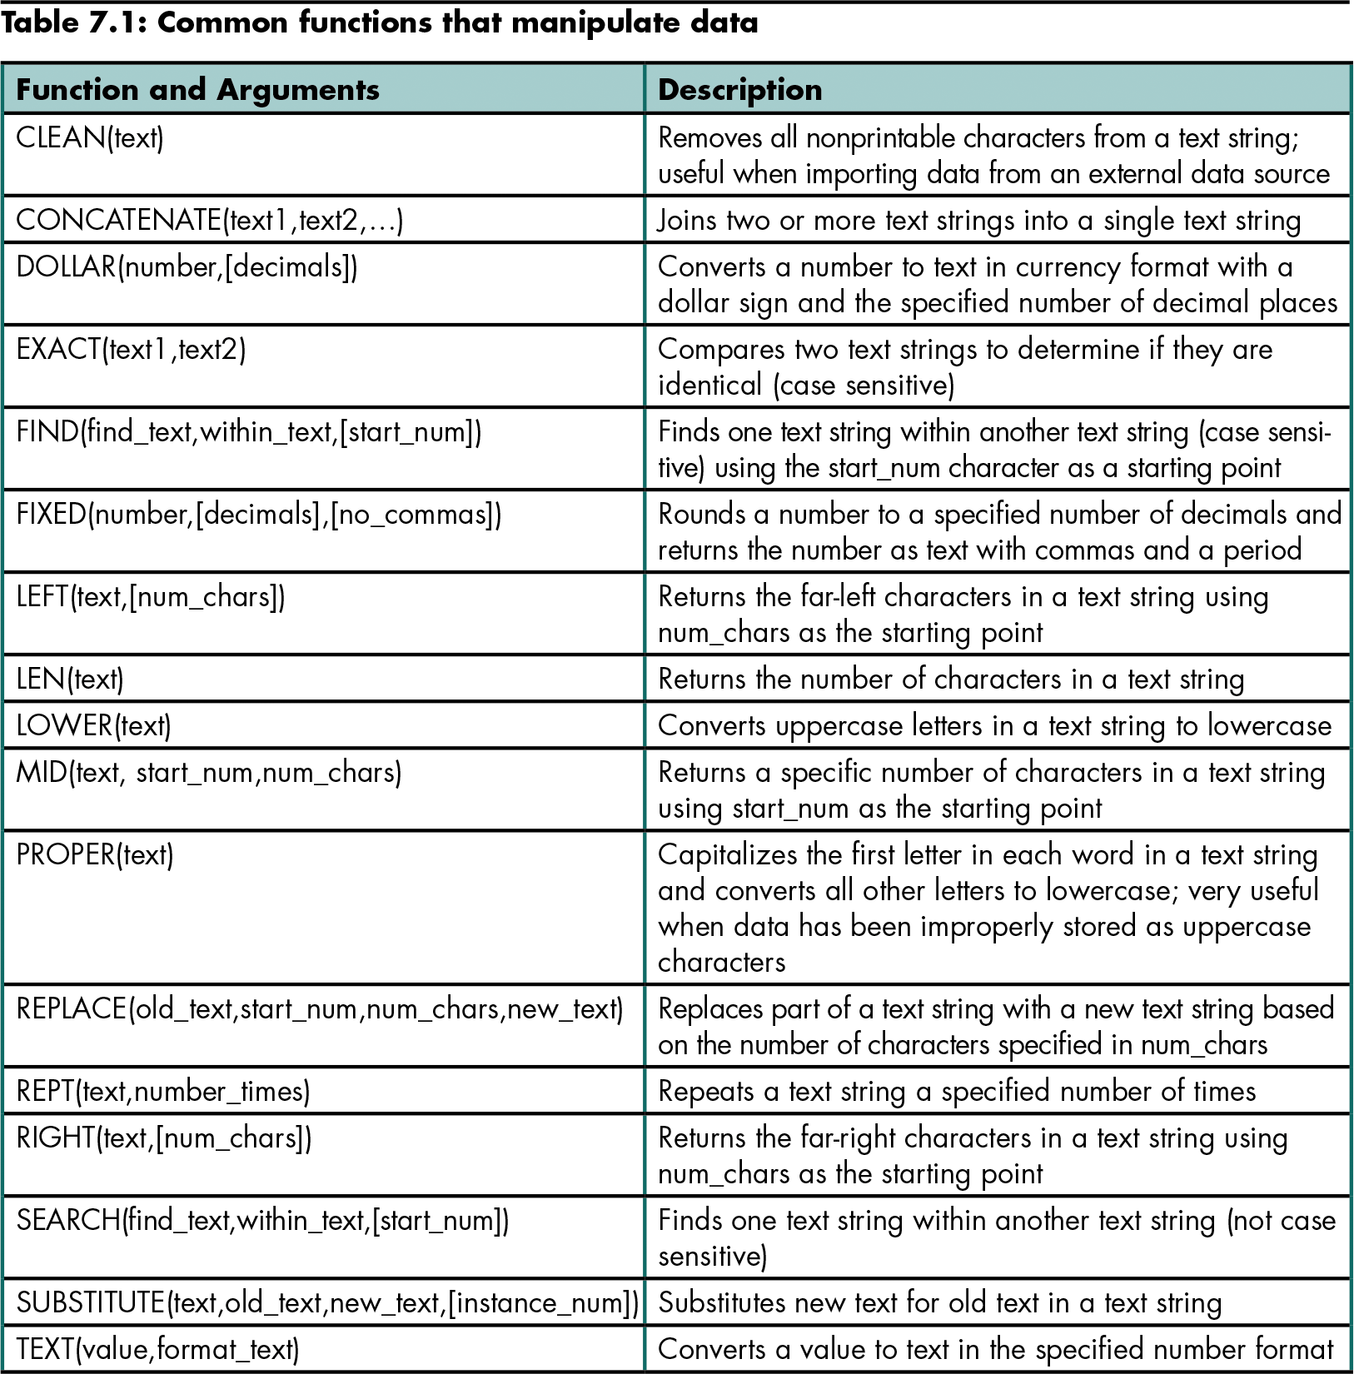
Level 1 home

Slide 19
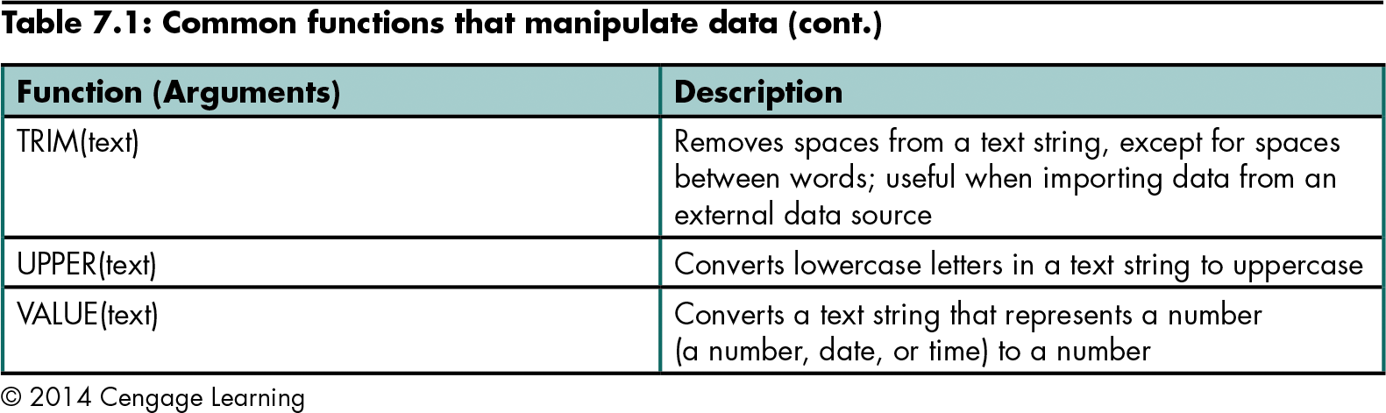
Extracting Characters from a Text String (continued)
Level 1 home

Slide 20
Converting Text into Columns of Data
Convert Text to Columns Wizard
Separates values in a text string into columns or fields
Two ways to parse text into columns:
Identify the character that delimits the data
Set field widths to identify the breaks between data that appears in columns
Level 1 home

Slide 21
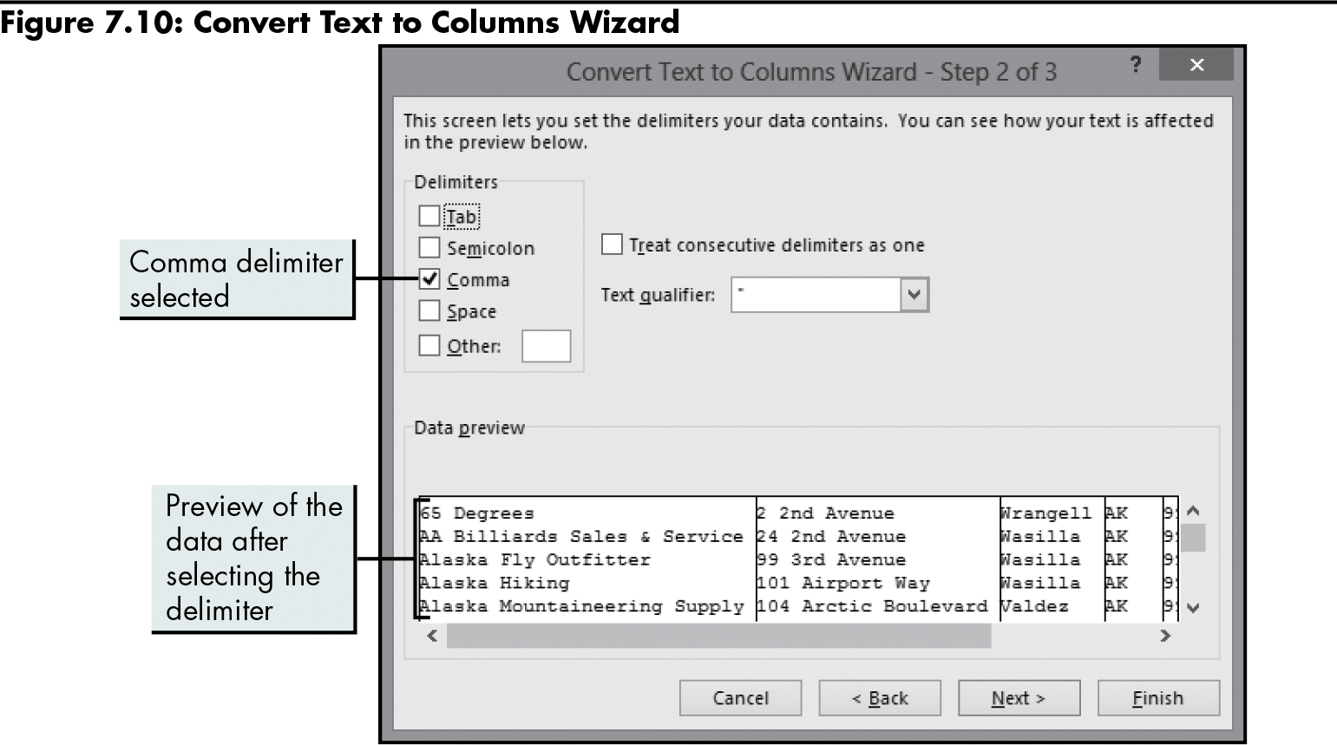
Converting Text into Columns of Data (continued)
Level 1 home

Slide 22
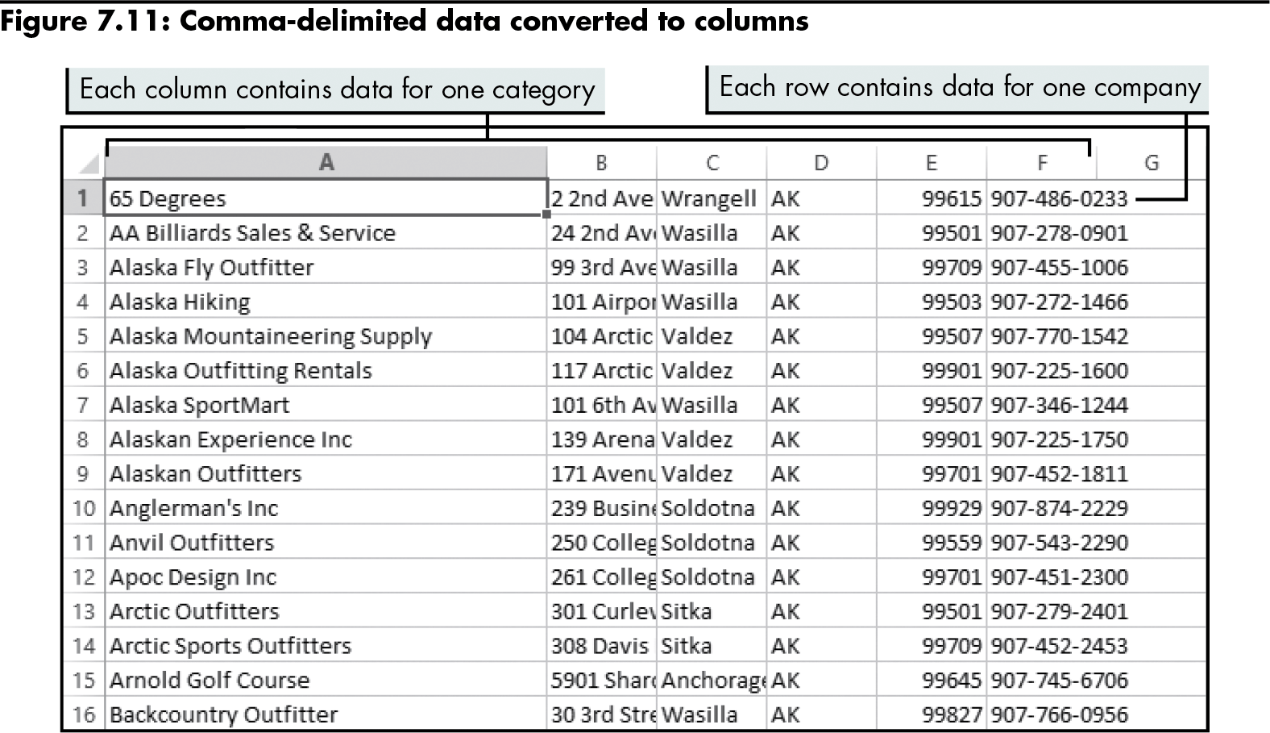
Converting Text into Columns of Data (continued)
Level 1 home

Slide 23
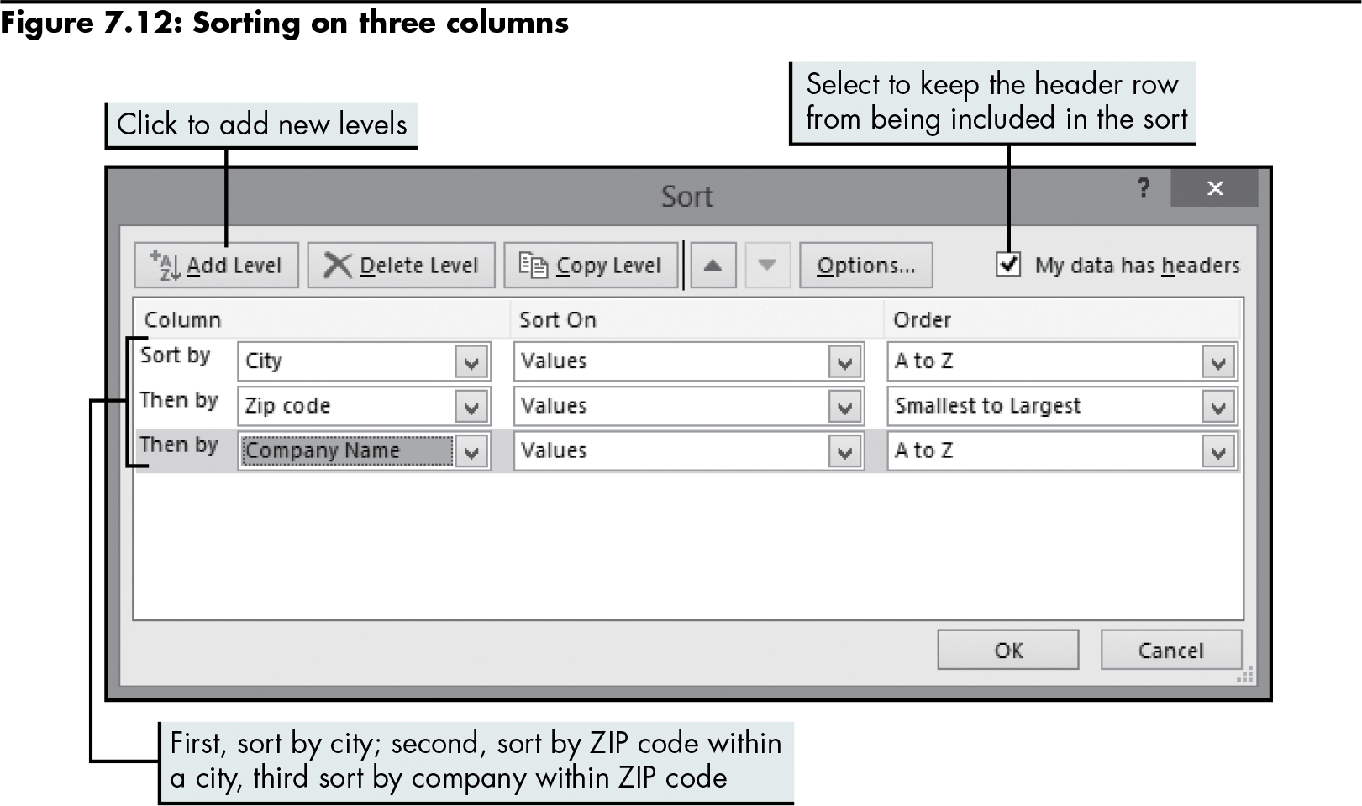
Converting Text into Columns of Data (continued)
Level 1 home

Slide 24
Analyzing Data by Creating Subtotals
Subtotal command
Creates summary reports that quickly organize data into categories with subtotal calculations
Can collapse and expand the level of detail in the report
Level 1 home

Slide 25
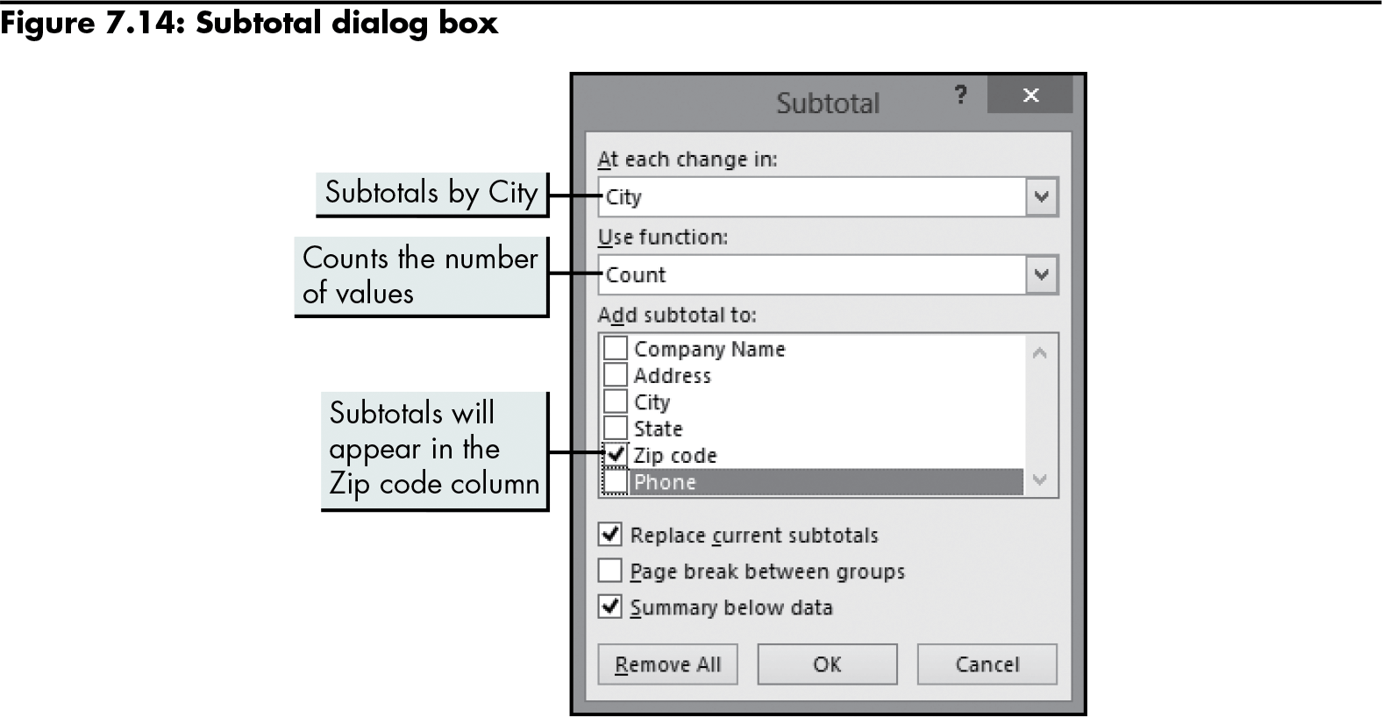
Analyzing Data by Creating Subtotals (continued)
Level 1 home

Slide 26
Creating and Working with an Excel Table
Excel table
A range of cells that are formalized as a single unit
Adds many features that aren’t available in an unstructured list (validation, sorting, filtering)
Protects the integrity of data
Data in the columns of each row automatically remains intact when it is filtered or sorted
Limitations:
Limit of 1,048,576 rows and 16,384 columns
The entire workbook must be loaded into memory
Level 1 home

Slide 27
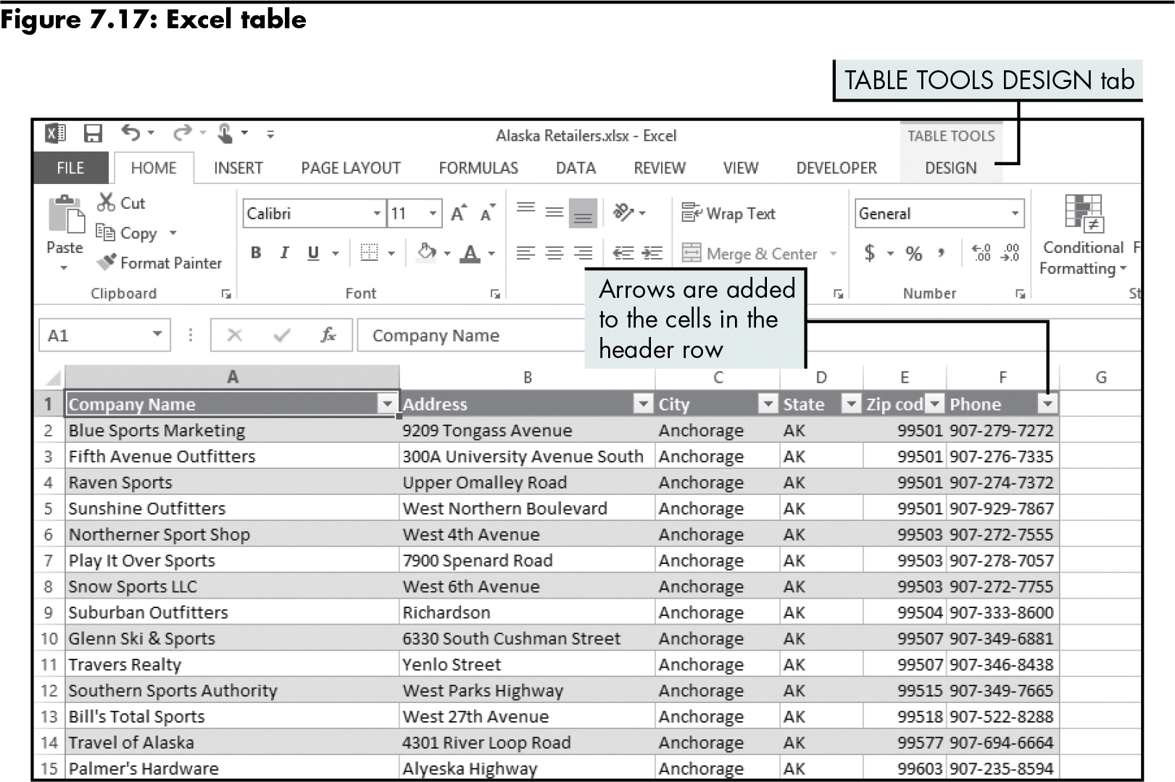
Creating and Working with an Excel Table (continued)
Level 1 home

Slide 28
Creating and Working with an Excel Table (continued)
Sorting an Excel table
Automatic, once you select one cell in the column
Filtering an Excel table
Lets you display data based on criteria you specify
Adding data to an Excel table
Type data into a blank row at the bottom of the table
Use a form
Level 1 home

Slide 29
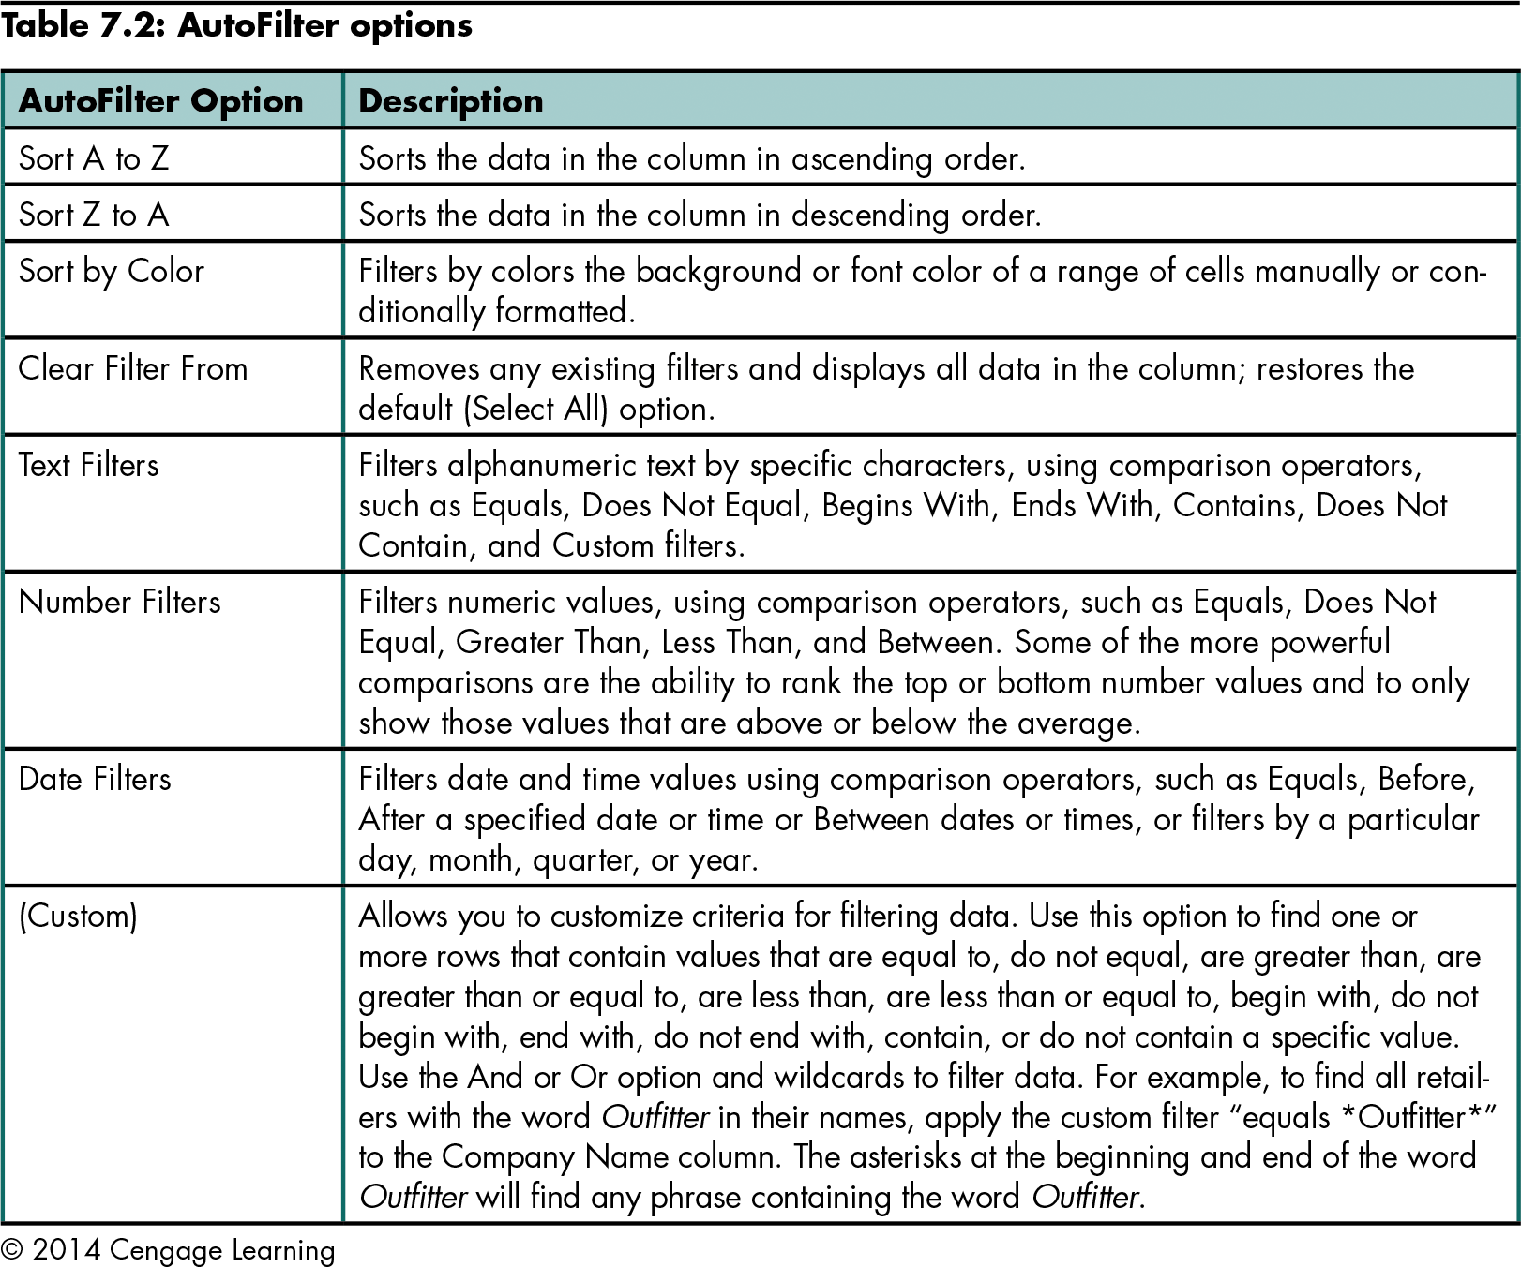
Creating and Working with an Excel Table (continued)
Level 1 home

Slide 30
Level 1 Summary
Importing data stored in a text file into Excel
Using Excel functions
CONCATENATE to combine multiple text strings into a single text string
TRIM to trim unnecessary spaces from a text string
RIGHT to find and extract characters from a text string
FIND to find specific characters in a text string

Slide 31
Level 1 Summary (continued)
Transforming delimited data into rows and columns of data that can be sorted and filtered using Excel tools
Creating subtotals to analyze data
Creating and working with data stored in an Excel table

Slide 32
Level 2 Objectives: Analyzing Data Imported from a Database and Organizing Data with a PivotTable Report
Import data stored in a database into Excel
Use dates and times in calculations
Analyze data using a PivotTable report
Create a PivotChart report

Slide 33
Importing Data from a Database into Excel
Database | A set of related data that is stored in tables
Table | A collection of fields that describe a specific entity
Field | A single characteristic of the entity
Record | A set of fields that describes one product or person
Database management system | A software program that creates and accesses data in a database (e.g., Microsoft Access and Oracle)
Level 2 home

Slide 34
Importing Data from a Database into Excel (continued)
Database
Provides the structure to ensure that the right data is available and protected
Spreadsheet
Provides analytical power and flexibility
Reduce data redundancy by storing data in related tables in a normalized database
Level 2 home

Slide 35
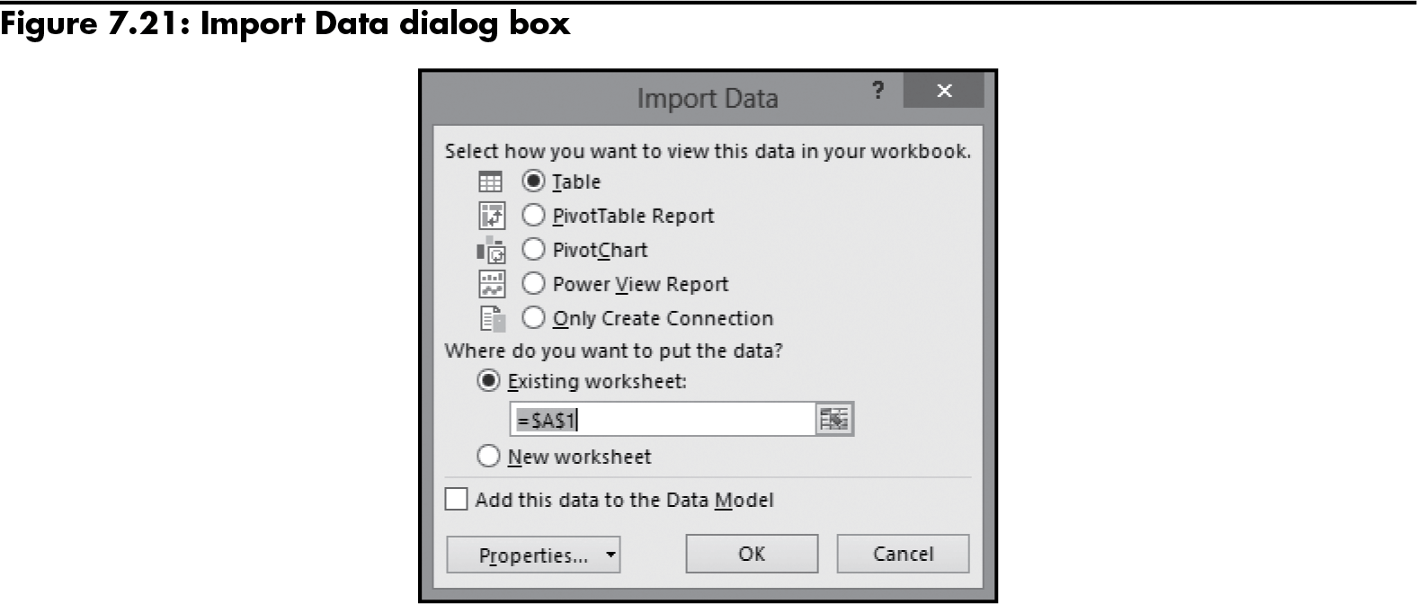
Importing Data from a Database into Excel (continued)
Importing an Access table into Excel
Level 2 home

Slide 36
Importing Data from a Database into Excel (continued)
Query Wizard in Microsoft Query
Lets you choose the data source, and select the database table and fields to import into the workbook
Prompts you to define criteria for the data you want to import by selecting only rows that meet criteria you specify
Level 2 home

Slide 37
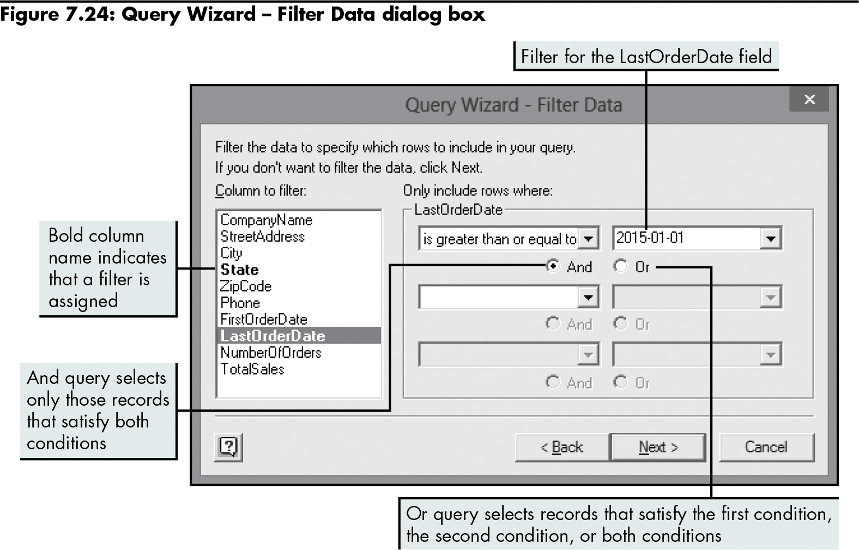
Importing Data from a Database into Excel (continued)
Level 2 home

Slide 38
Making Calculations with Date and Time Data
TODAY function
Returns the current date’s serial number (based on the computer’s internal clock)
=TODAY()
Requires no additional arguments
YEARFRAC function
Calculates the number of years between the two days
=YEARFRAC(start_date,end_date,[basis])
Level 2 home

Slide 39
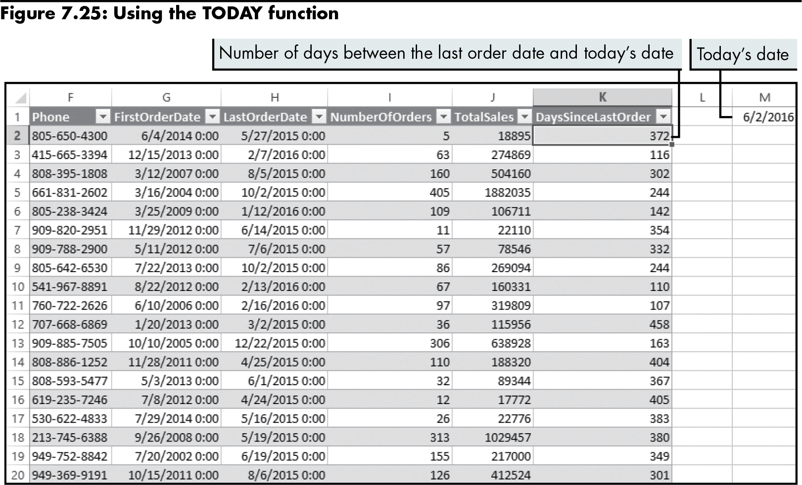
Making Calculations with Date and Time Data (continued)
Level 2 home

Slide 40
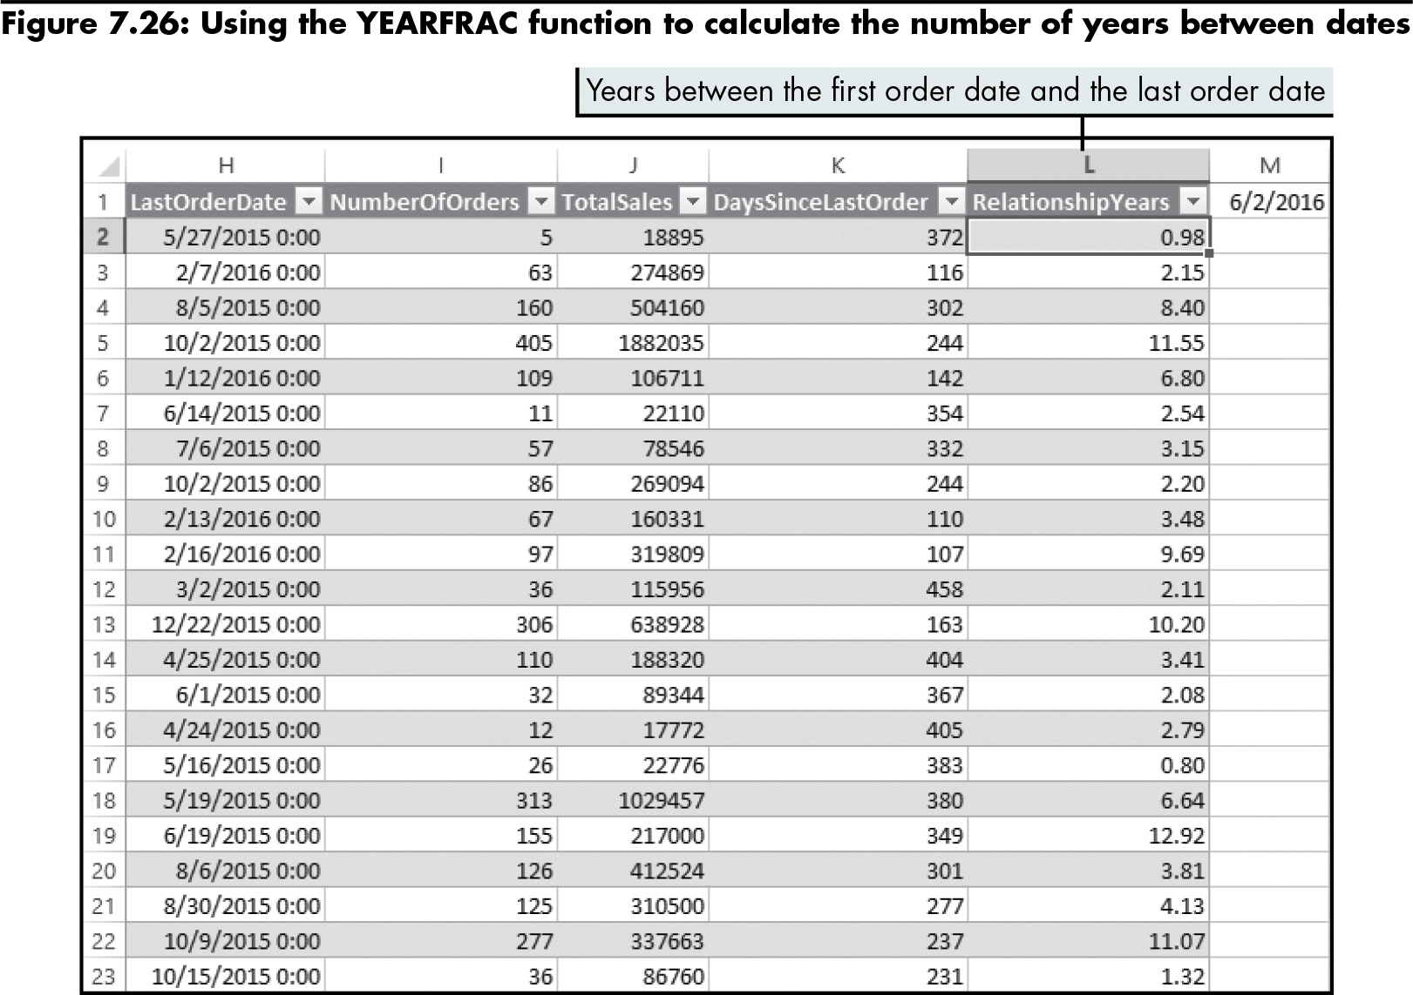
Making Calculations with Date and Time Data (continued)
Level 2 home

Slide 41
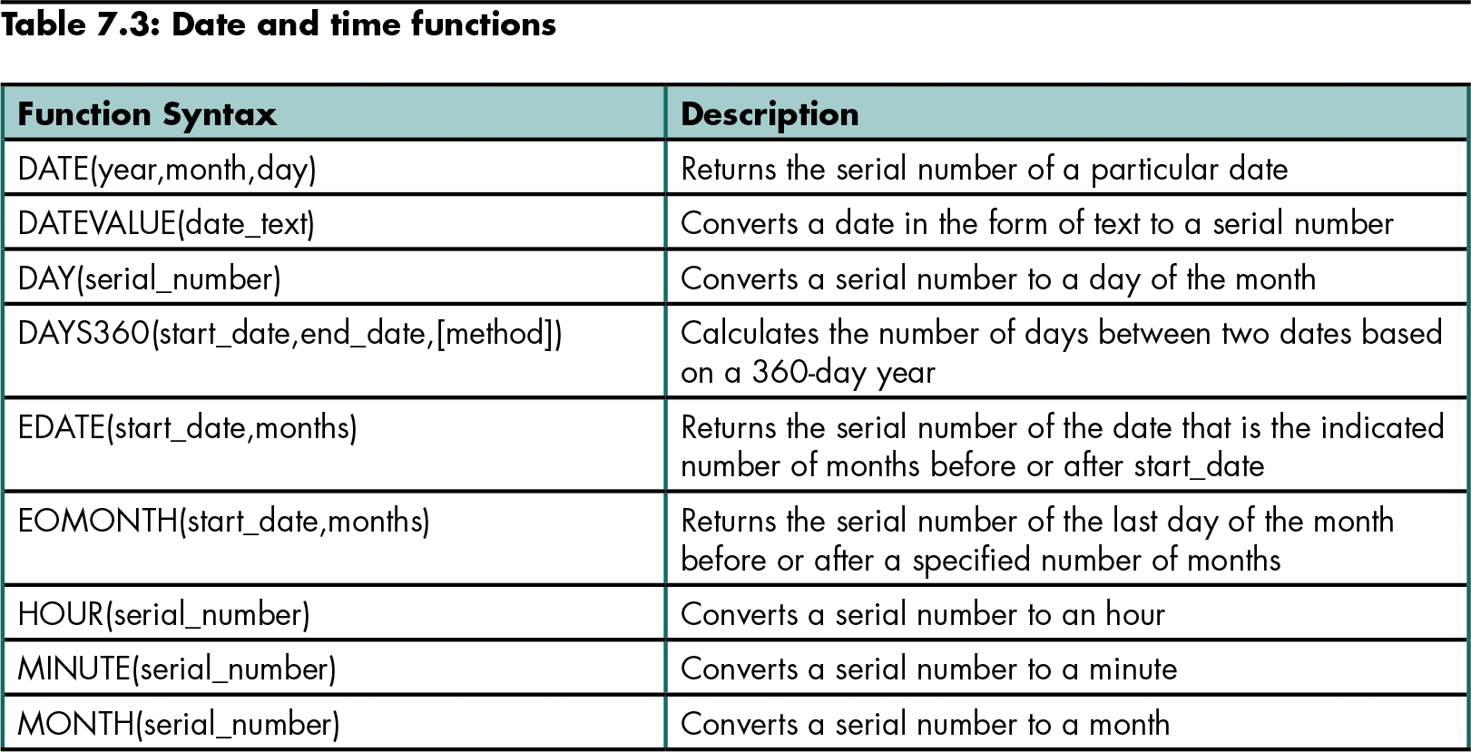
Making Calculations with Date and Time Data (continued)
Level 2 home

Slide 42
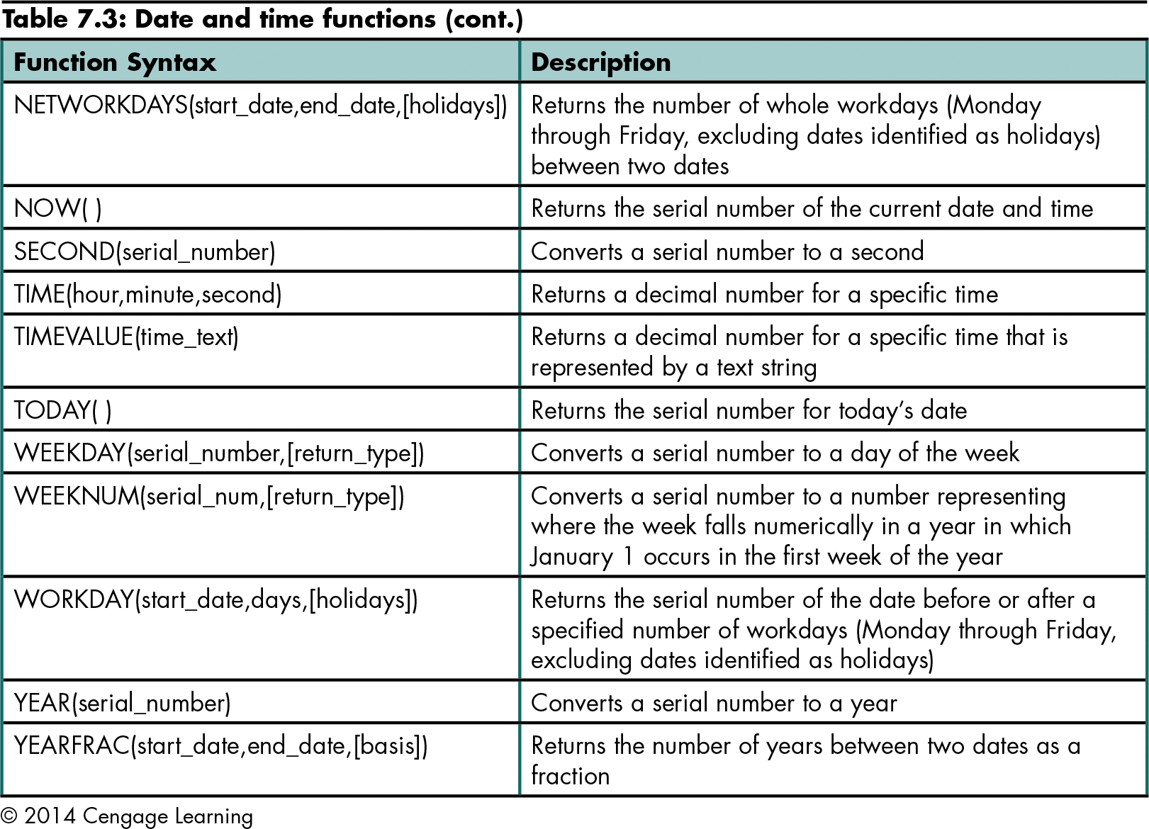
Making Calculations with Date and Time Data (continued)
Level 2 home

Slide 43
Analyzing Data Using a PivotTable Report
PivotTable report
An interactive report that lets you summarize and analyze a data set
Dynamic organization; can be “pivoted” to examine data from various perspectives by rearranging its structure
Best used to analyze data that can be summarized in multiple ways
Level 2 home

Slide 44
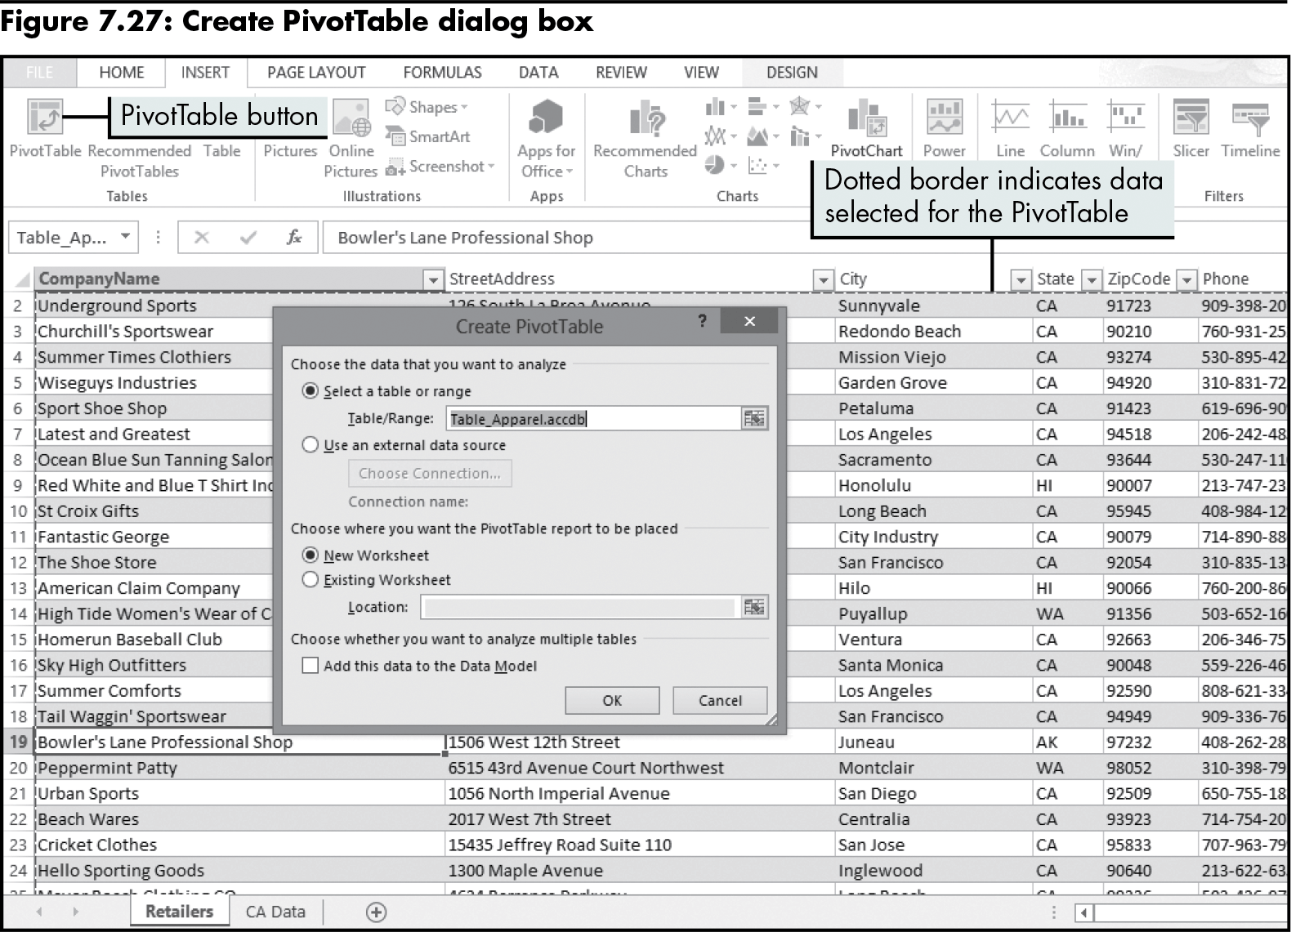
Analyzing Data Using a PivotTable Report (continued)
Level 2 home

Slide 45
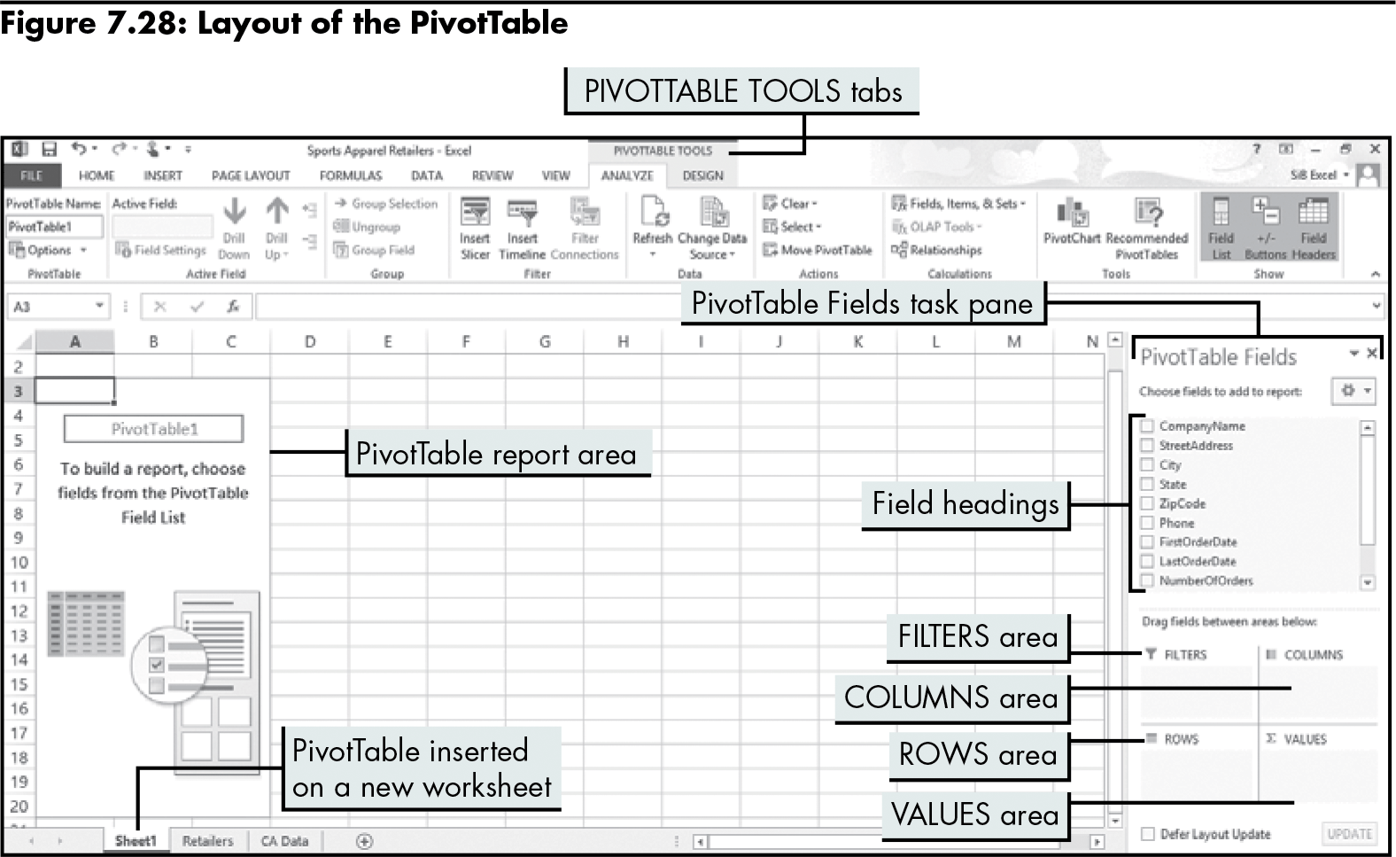
Analyzing Data Using a PivotTable Report (continued)
Level 2 home

Slide 46
Analyzing Data Using a PivotTable Report (continued)
To add data to a PivotTable report, drag the field you want to summarize to a drop area on the report
The ROWS area displays data from that field in rows
The COLUMNS area displays data from that field in columns
The VALUES area summarizes data from that field
Level 2 home

Slide 47
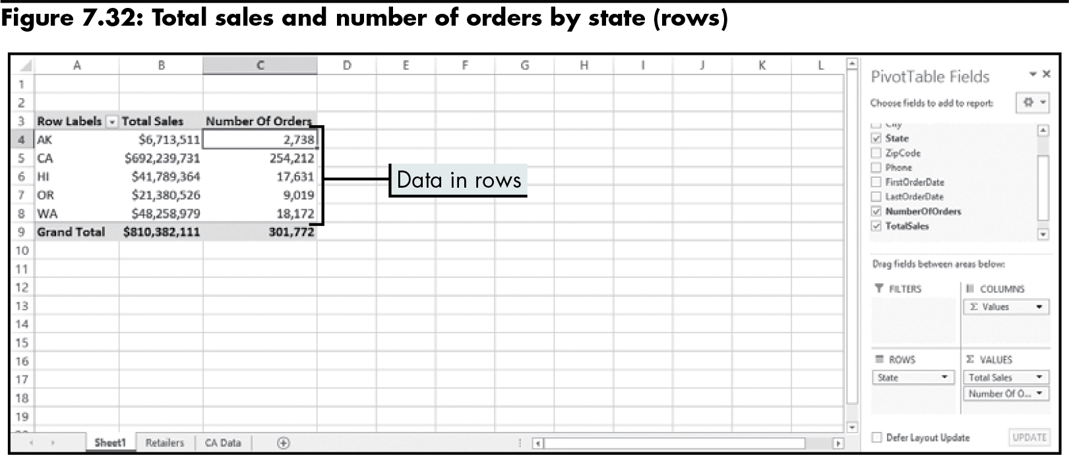
Analyzing Data Using a PivotTable Report (continued)
Level 2 home

Slide 48
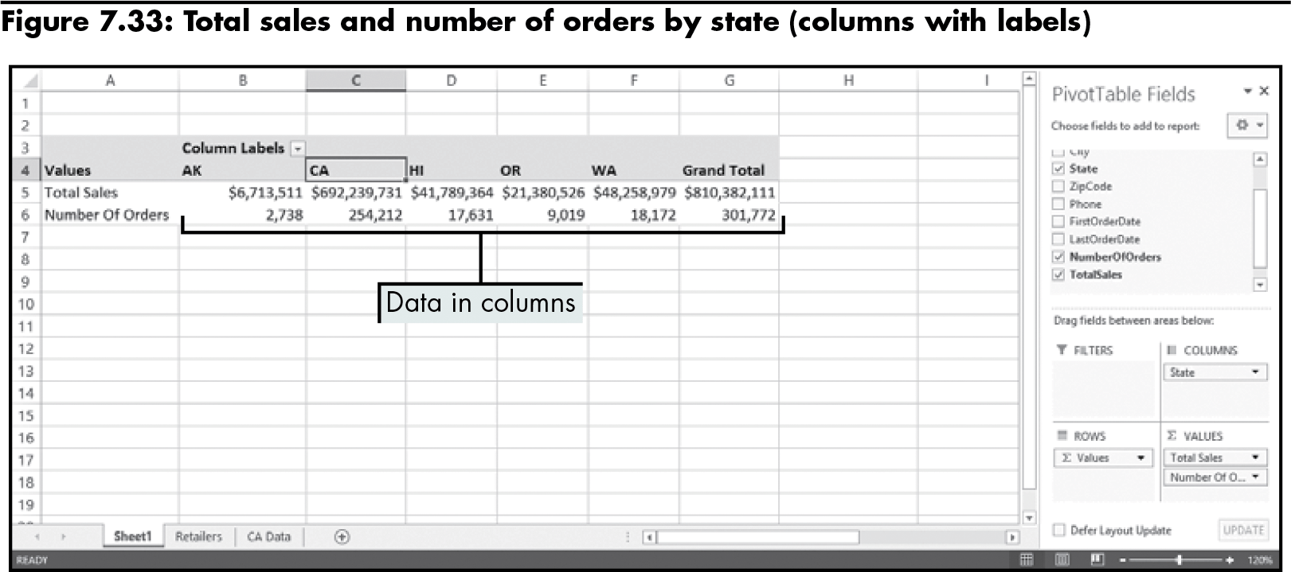
Analyzing Data Using a PivotTable Report (continued)
Level 2 home

Slide 49
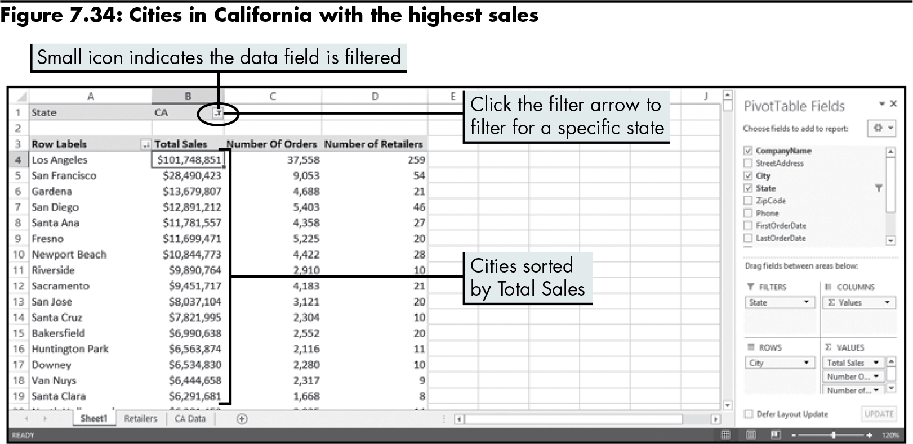
Analyzing Data Using a PivotTable Report (continued)
Adding fields to the page area
Level 2 home

Slide 50
Analyzing Data Using a PivotTable Report (continued)
Using slicers to filter PivotTable data
Allows you to filter a current data set by the current values of a field
The field values are turned into buttons in the PivotTable report
Buttons are grouped into an object called a slicer
Level 2 home

Slide 51
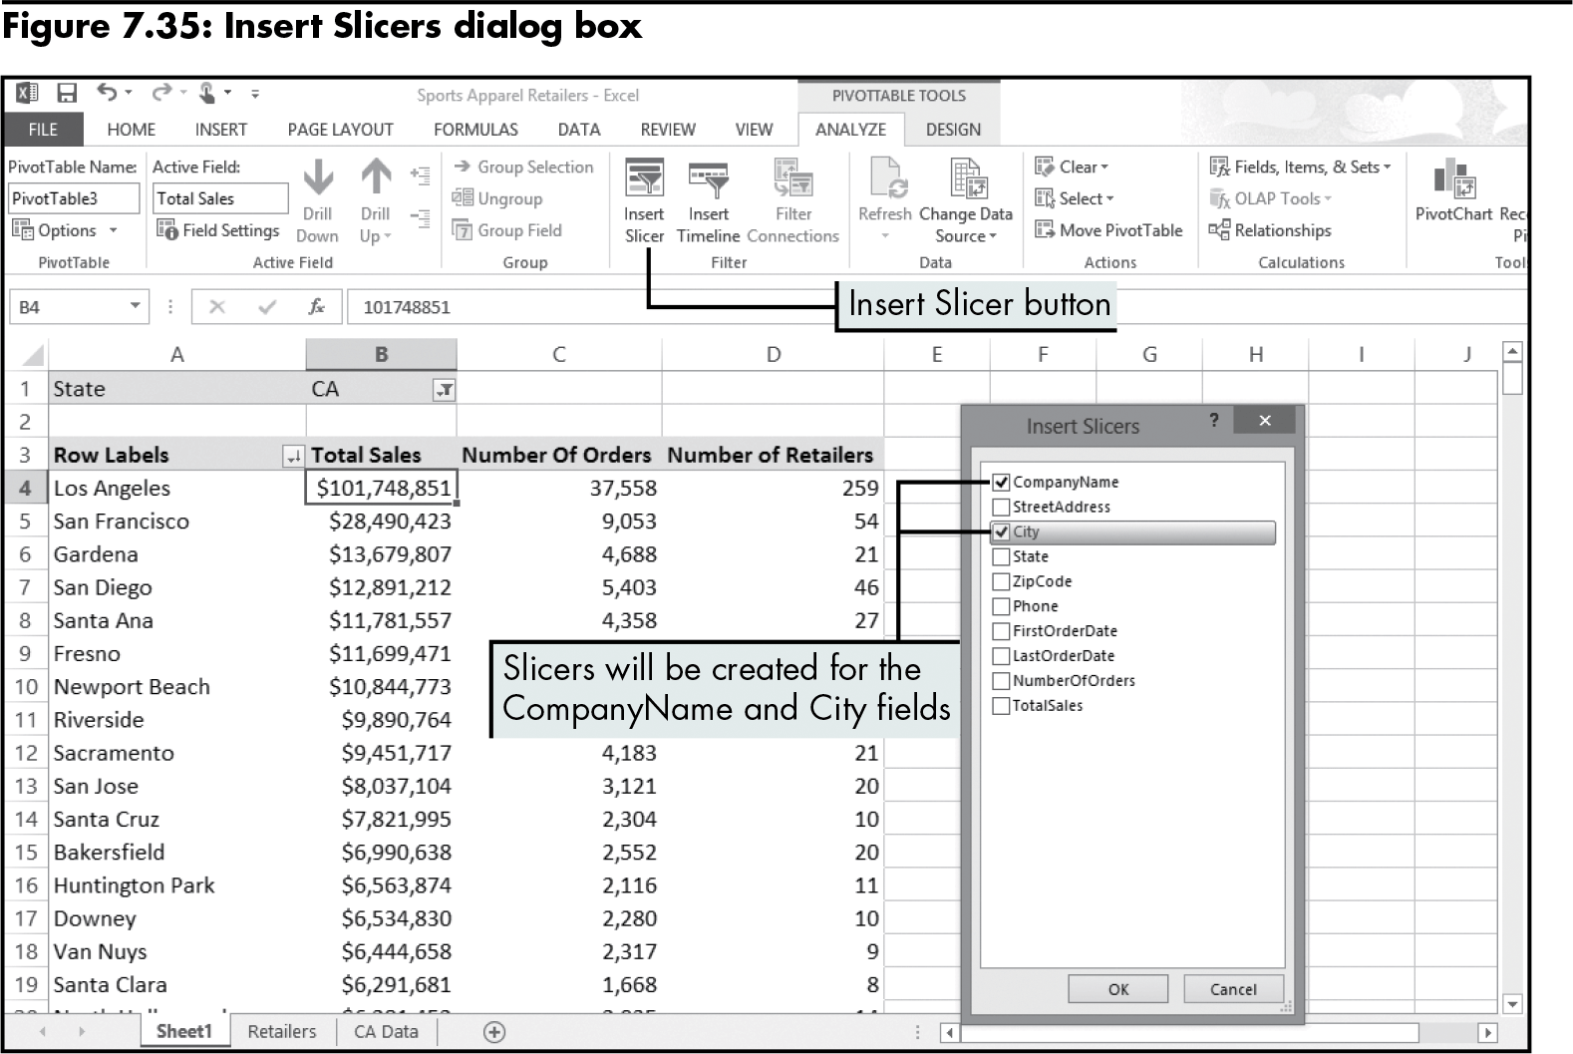
Analyzing Data Using a PivotTable Report (continued)
Level 2 home

Slide 52
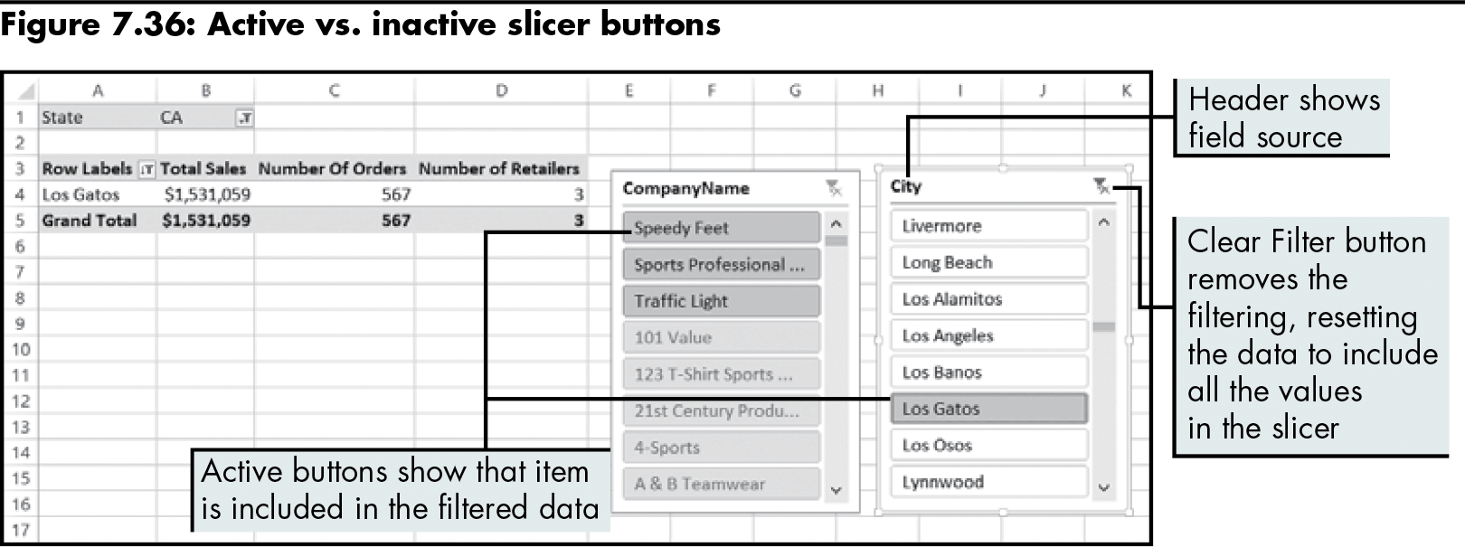
Analyzing Data Using a PivotTable Report (continued)
Level 2 home

Slide 53
Analyzing Data Using a PivotTable Report (continued)
PivotChart report
Represents the source data as a graphic
The easiest way to create a PivotChart report is to use an existing PivotTable report
Level 2 home

Slide 54
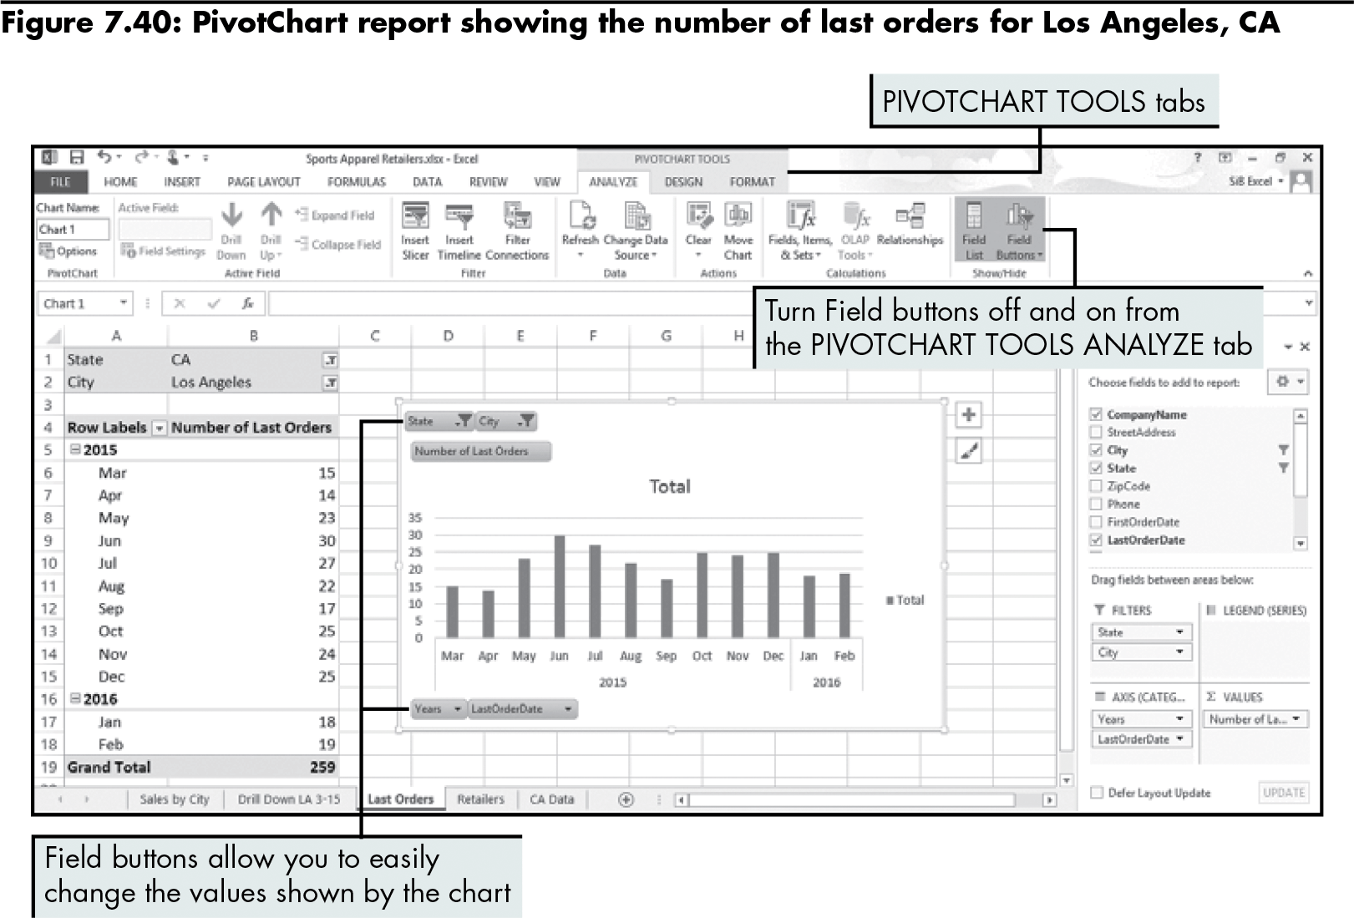
Analyzing Data Using a PivotTable Report (continued)
Level 2 home

Slide 55
Level 2 Summary
Using a database to store data that can be exported to Excel for analysis
Using the Query Wizard to select specific records in a database and import them into Excel
Understanding how Excel stores and works with dates and times
Using dates in calculations to determine the number of days and years between two dates
Creating and using a PivotTable report

Slide 56
Level 3 Objectives: Importing and Exporting XML Data
Understand markup languages and XML
Import XML data into Excel as an XML table
Add an XML map to a workbook
Analyze XML data with Excel
Export XML data from Excel into an XML document

Slide 57
Understanding Markup Languages and XML
Markup language
A link between content and instructions for formatting that content
Uses a set of tags to distinguish different elements in a document
Examples:
HTML (Hypertext Markup Language)
SGML (Standard Generalized Markup Language)
XML (Extensible Markup Language)
Level 3 home

Slide 58
Understanding Markup Languages and XML (continued)
Markup Languages
HTML | SGML | XML
Creates Web pages (HTML documents) Embeds tags in a document to describe how to format the content Most browsers read and interpret HTML tags in the same way | Divides a document into elements Document type definition (DTD) identifies elements in a document and their structural relationships Allows the definition of other markup languages | Combines the markup power of SGML with HTML’s ease of use Defines the structure and rules for creating markup elements Stores information in a nonproprietary format
Level 3 home

Slide 59
Understanding Markup Languages and XML (continued)
XML documents
User-defined documents in which the user develops a DTD or schema that defines the elements contained in a document, and descriptions of how those elements are related to each other
Data can be combined with metadata
<shoe>
<shoe_ID>SH-1987</shoe_ID>
<shoe_name>Running shoe</shoe_name>
<description>Men’s size 11, white</description>
</shoe>
Level 3 home

Slide 60
Analyzing XML Data with Excel
Import data into a worksheet; the method depends on the data
Import the entire XML document as a list (root element, schema)
Use the XML Source task pane to map elements you need to columns in a list
Export XML data as a “well-formed” XML document
Level 3 home

Slide 61
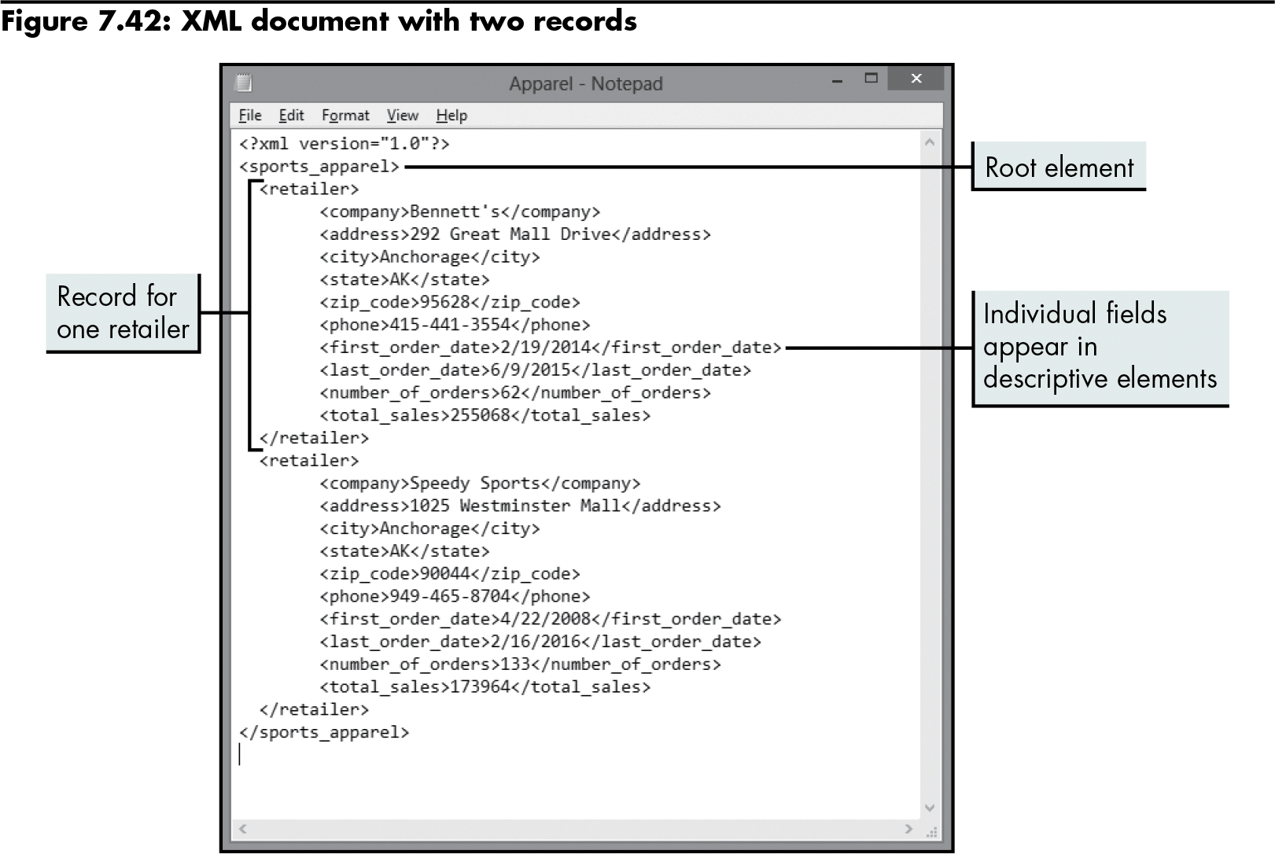
Importing XML Data as an XML Table
Level 3 home

Slide 62
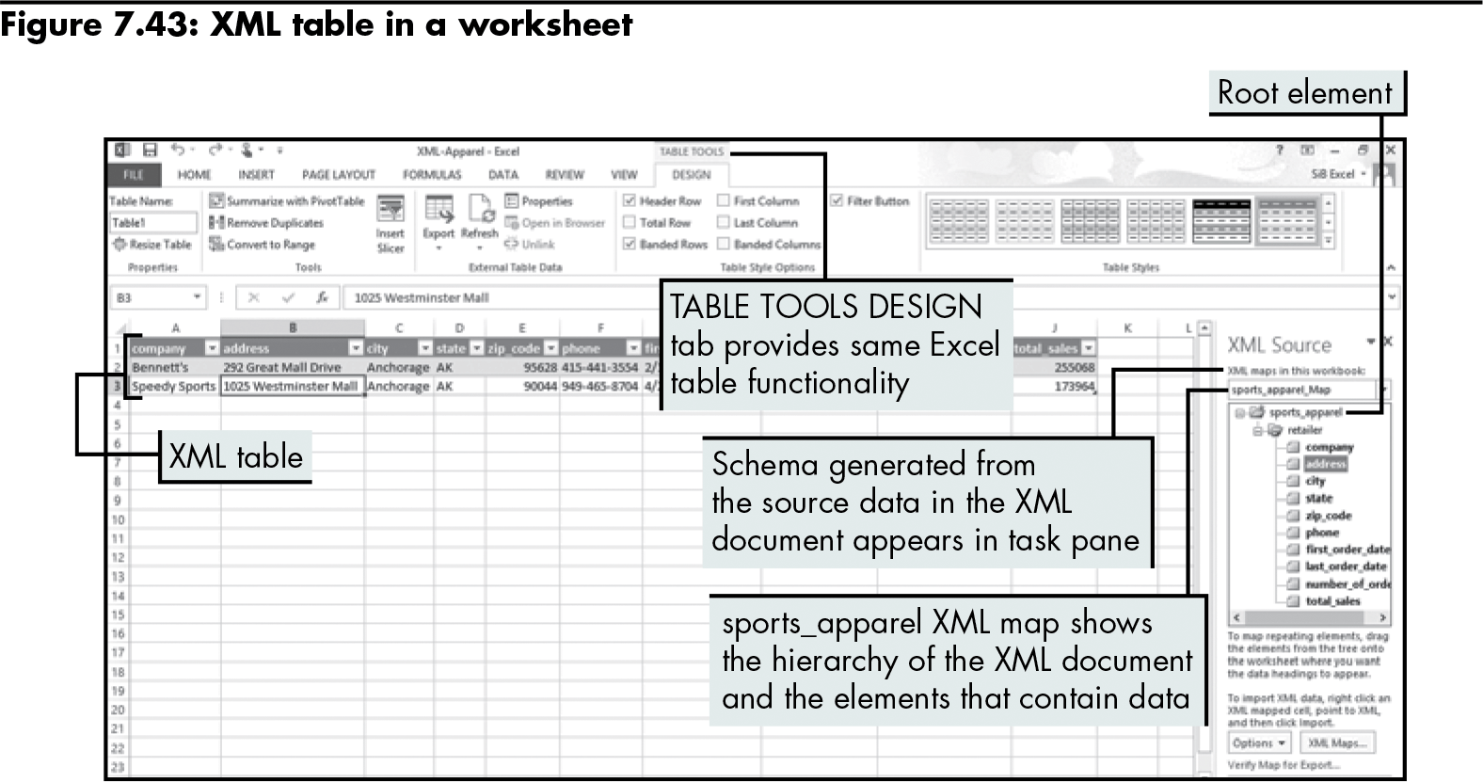
Importing XML Data as an XML Table (continued)
Level 3 home

Slide 63
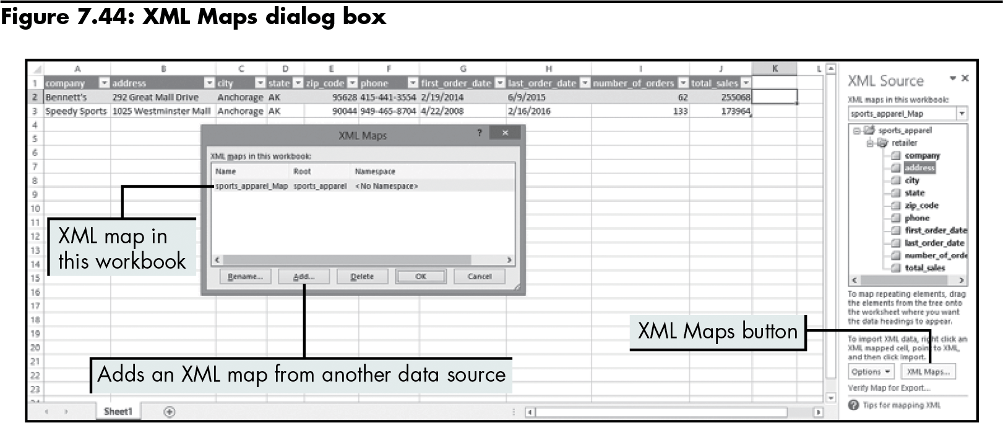
Adding an XML Map to a Workbook
Level 3 home

Slide 64
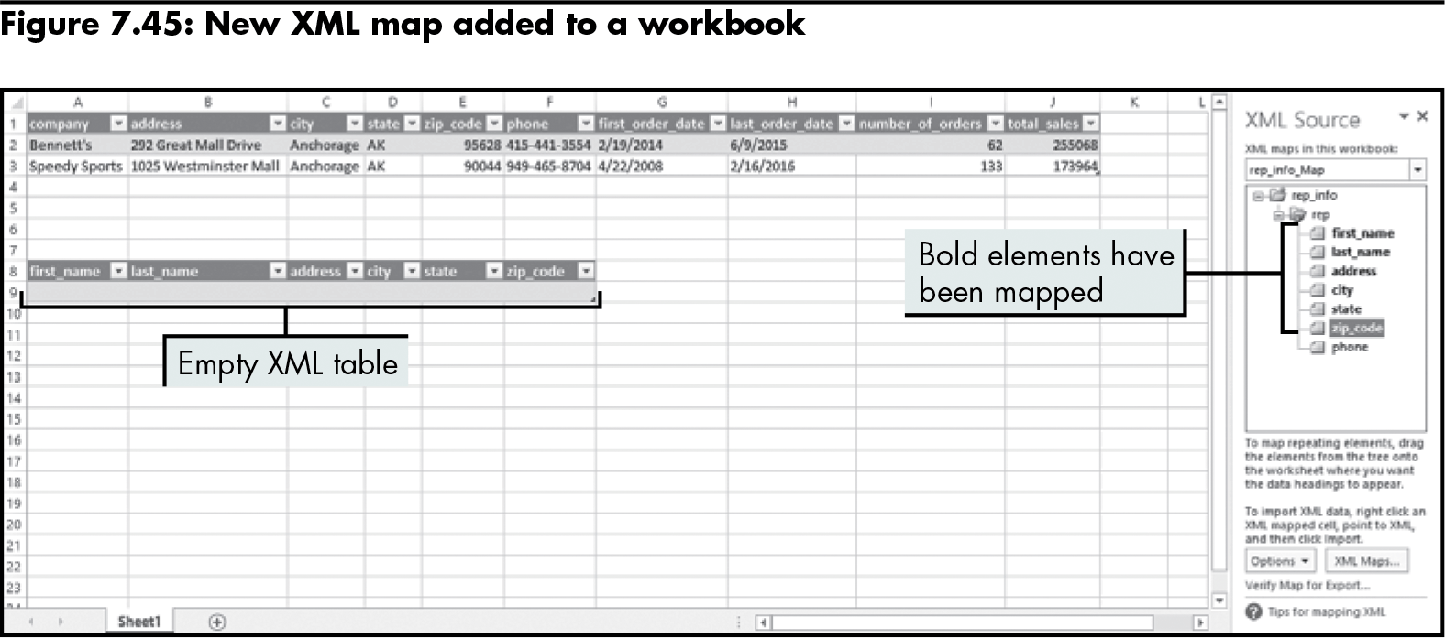
Adding an XML Map to a Workbook (continued)
Level 3 home

Slide 65
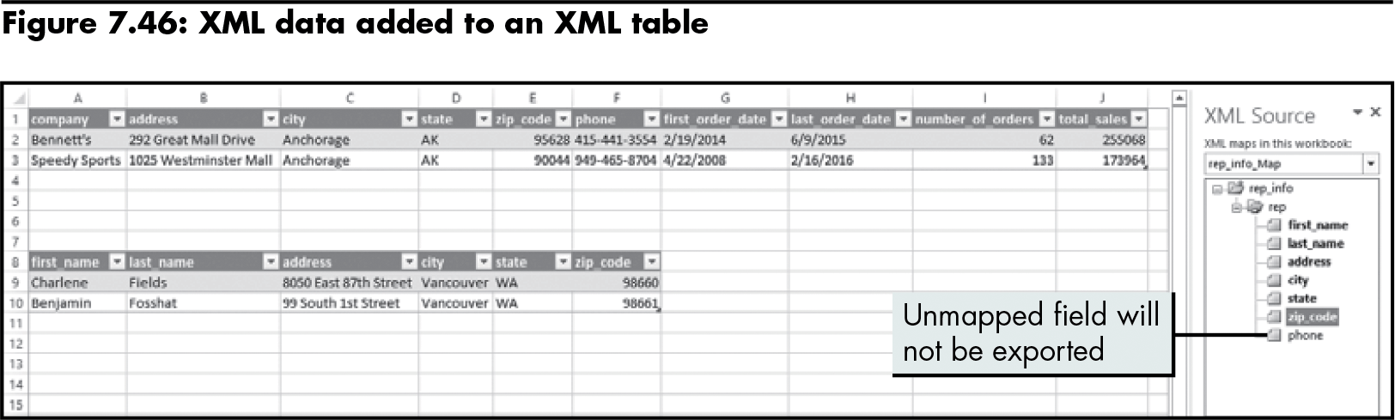
Adding an XML Map to a Workbook (continued)
Level 3 home

Slide 66
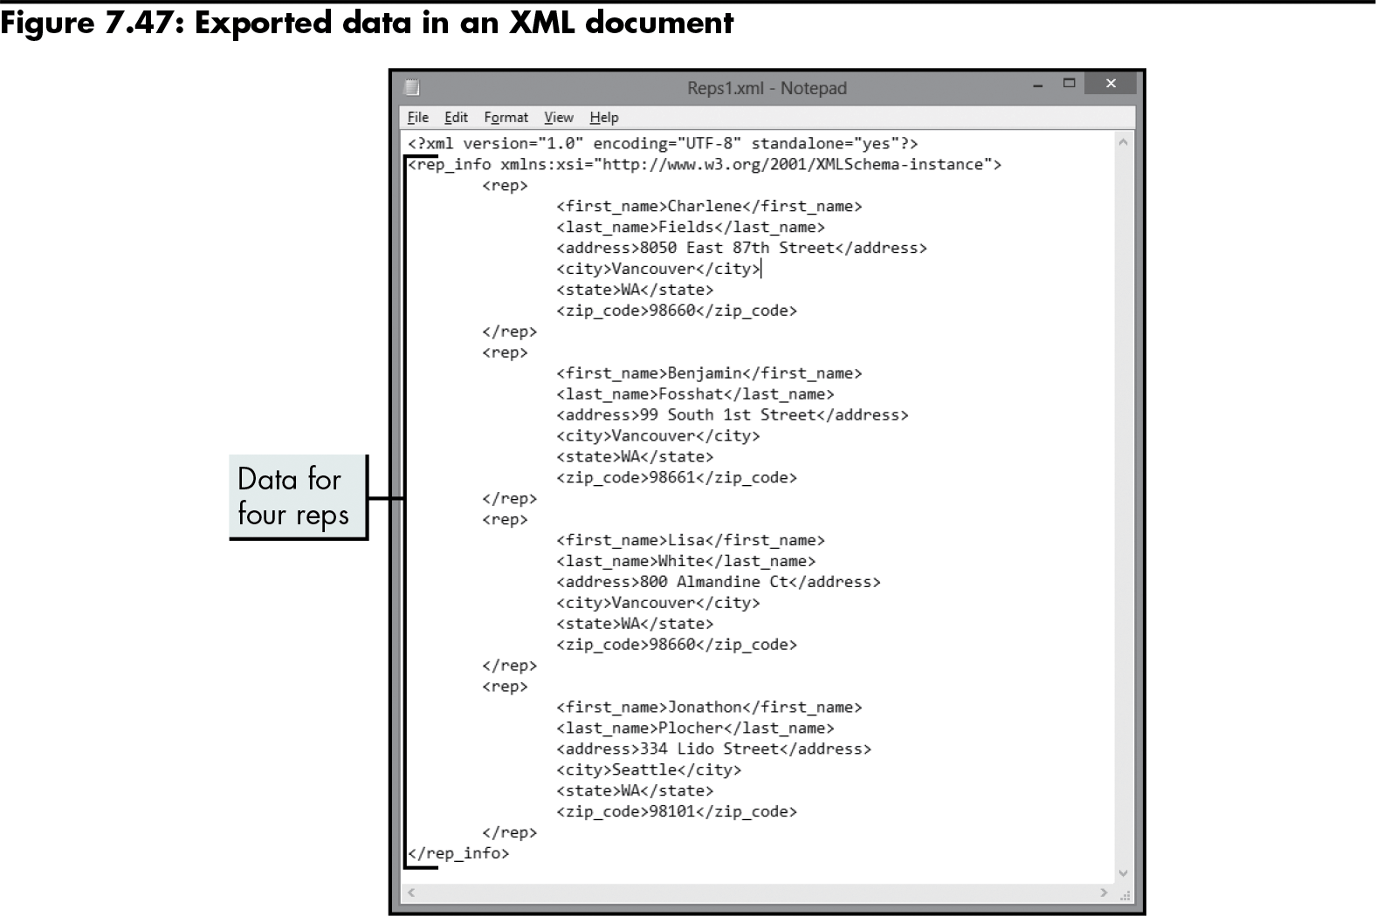
Exporting XML Data
Level 3 home

Slide 67
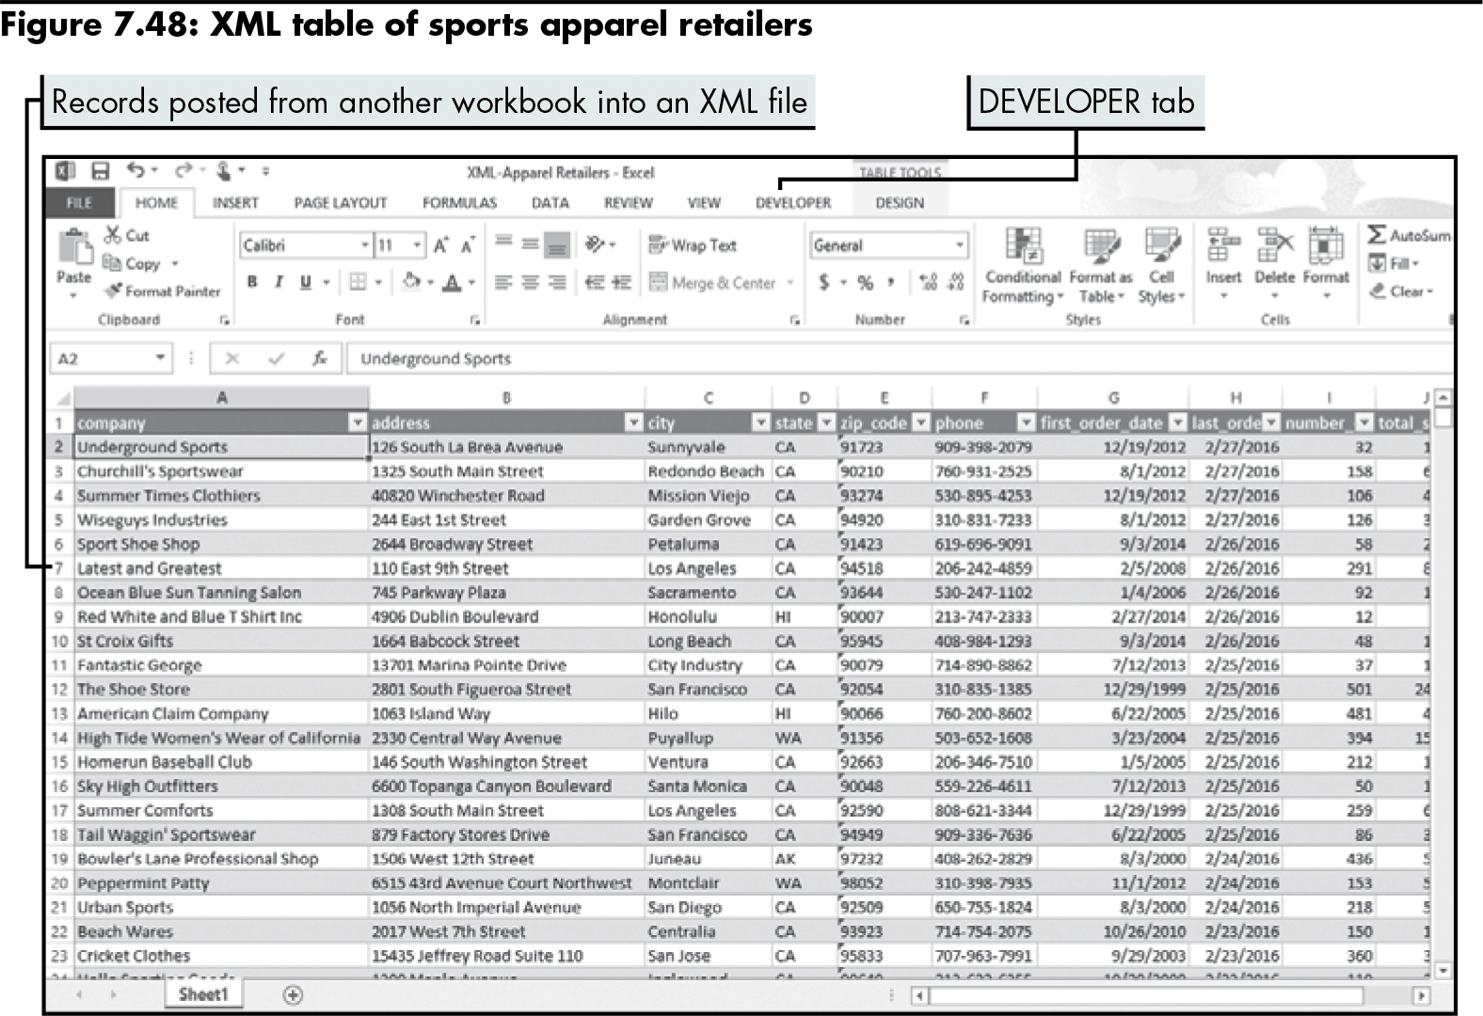
Exporting XML Data (continued)
Level 3 home

Slide 68
Level 3 Summary
Using different markup languages, including XML
Using an existing XML document to import an XML map in a workbook
Mapping XML elements into a worksheet
Importing data into an XML table and exporting data to an XML document

Slide 69
Chapter Summary
Importing and structuring text data in Excel worksheets
Analyzing data imported from a database and organizing data with a PivotTable report
Importing and exporting XML data

